Slide 2
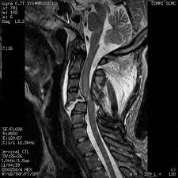
MRI

Slide 3
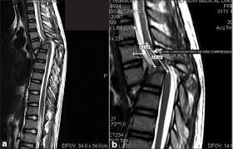

Slide 4
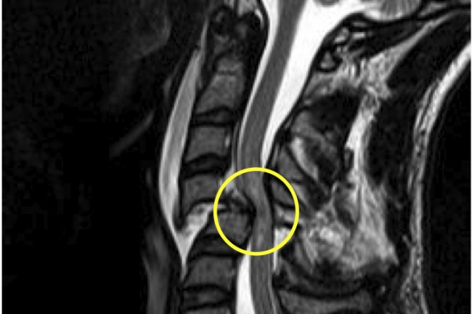

Slide 5
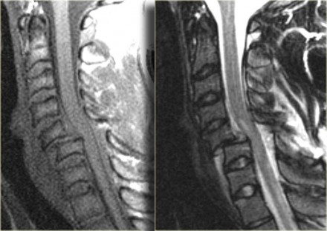
Bilateral interfacetal dislocation. The MRI-findings are: Soft tissue swelling anteriorly, Disruption of the disc

Slide 6
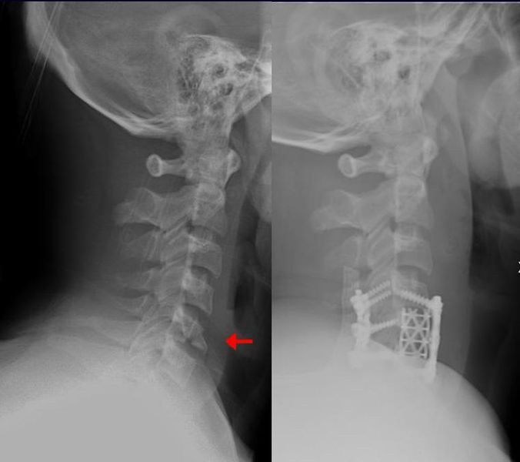
Teardrop fracture of the cervical spine before and after treatment with metal fixation.

Slide 7
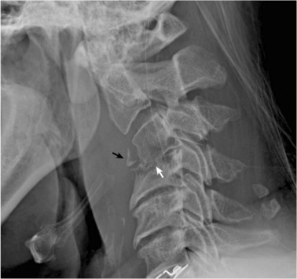
Cervical spine spondylodiscitis mimicking teardrop fracture
55-year-old male with cervical spine spondylodiscitis.
Spondylodiscitis is a combination of discitis (inflammation of one or more intervertebral disc spaces) and spondylitis (inflammation of one or more vertebrae), the latter generally involving the areas adjacent to the intervertebral disc space.

Slide 8
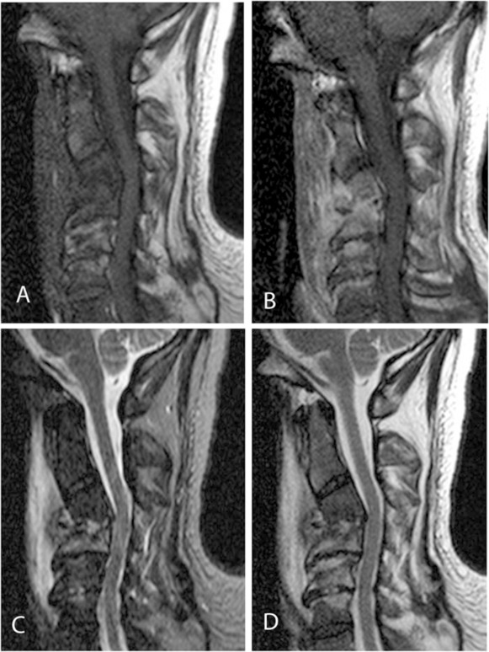
spondylodiscitis
55-year-old male with cervical spine spondylodiscitis.

Slide 9
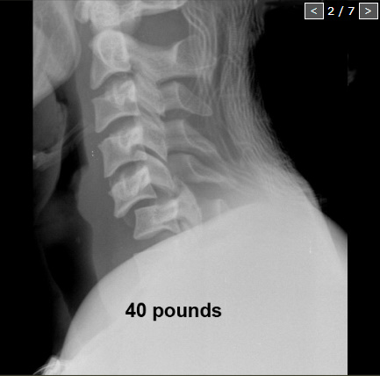
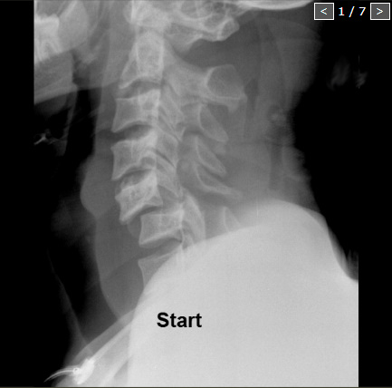
In order to regain normal alignment, progressive weights are used to lengthen the spine until reduction is achieved. Scroll through the images on the left. Notice, that with 40 pounds the facets start to move, but it finally takes about 110 pounds before the neck is reduced.
Because someone is holding on to the neck while more weight is added, an actual 'clunk' can be felt in the neck indicating that reduction is achieved.

Slide 11
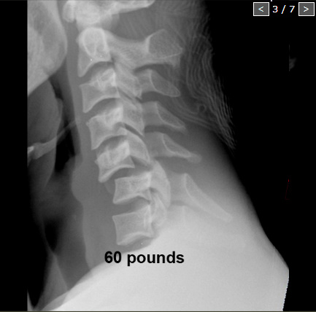

Slide 12
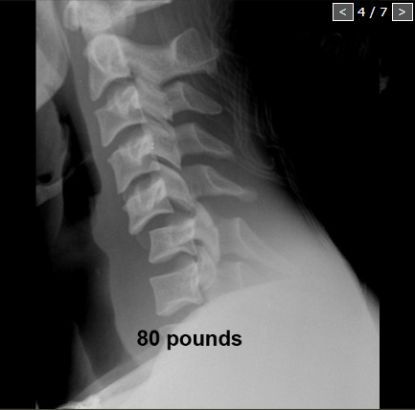

Slide 13
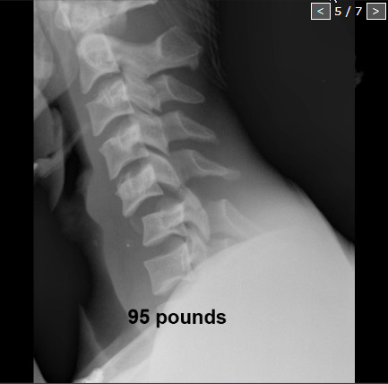

Slide 14
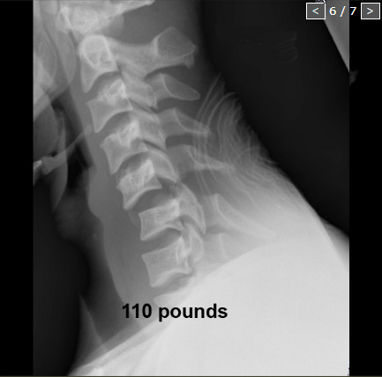

Slide 15
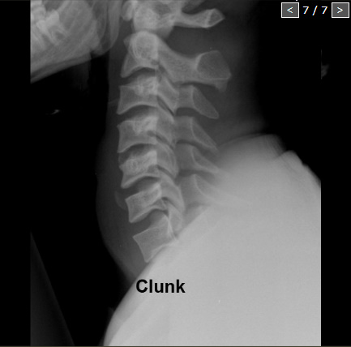

Slide 16
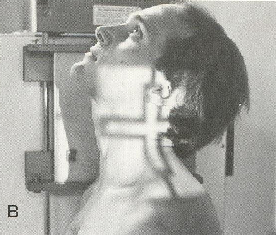
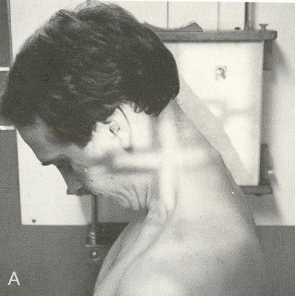
Cervical spine Flexion/Extension lateral cervical

Slide 17
Cervical spine Flexion/Extension lateral cervical

Slide 18
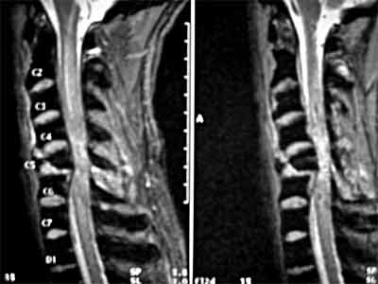
Sagittal T2 weighted image of the Cervical spine demonstrating focal cord compression at fracture site and displaying cord T2 hyper intensity due to cord contusion.

Slide 19
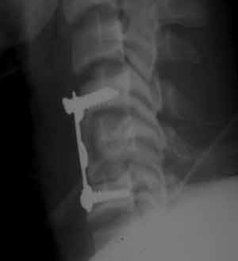
Internal fixation involving vertebrae above
and below site of fracture

Slide 20
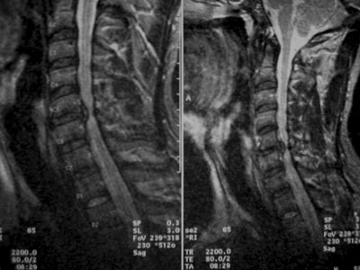
Post traumatic posterior disc bulge Cv5-6

Slide 21
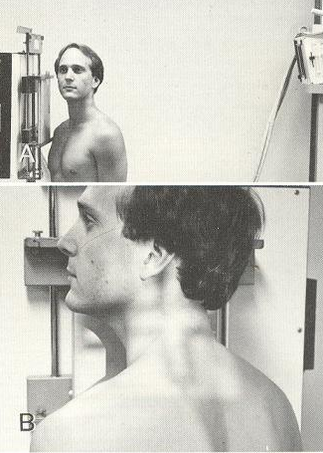
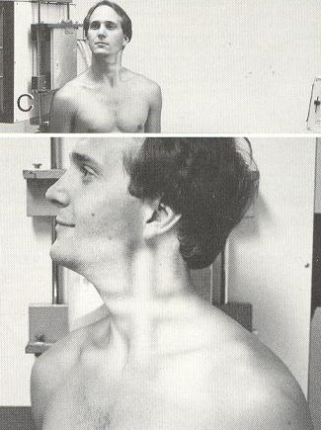
Cervical spine Cervical obliques

Slide 22
Cervical spine Posterior Oblique Cervical

Slide 23
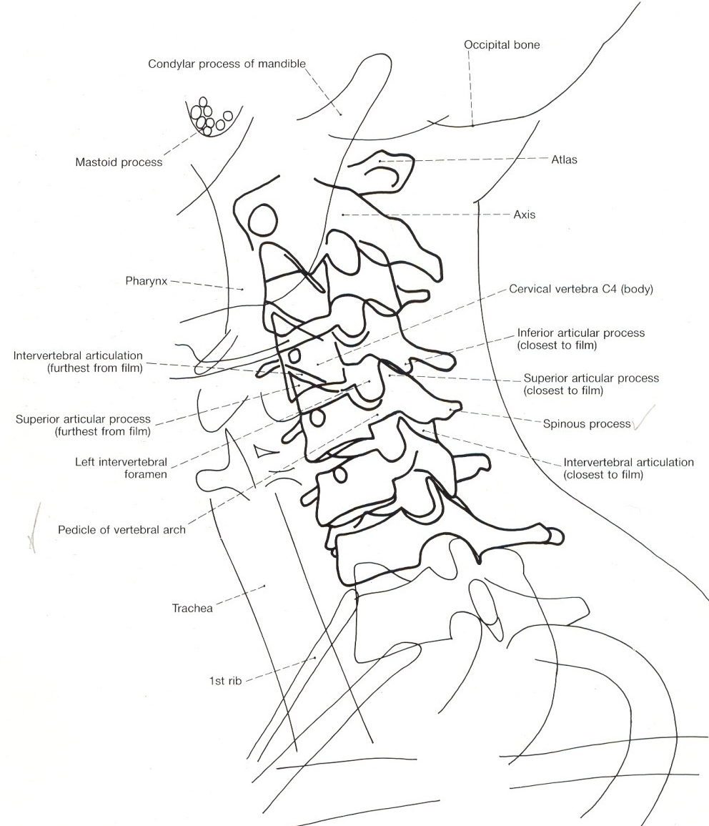
Oblique Radiograph of the Cervical Spine

Slide 24
Measurements

Slide 25
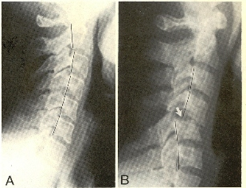
George’s line

Slide 26
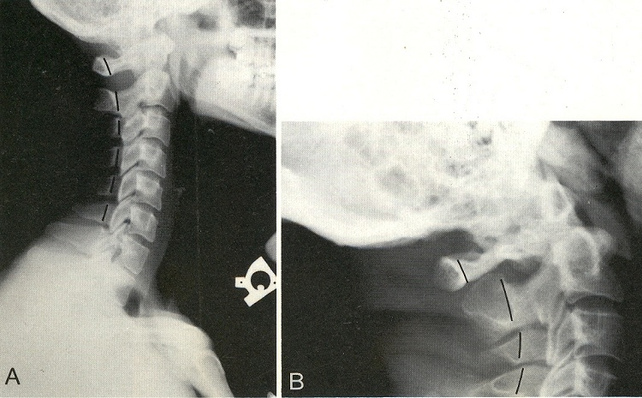
Posterior cervical line

Slide 27
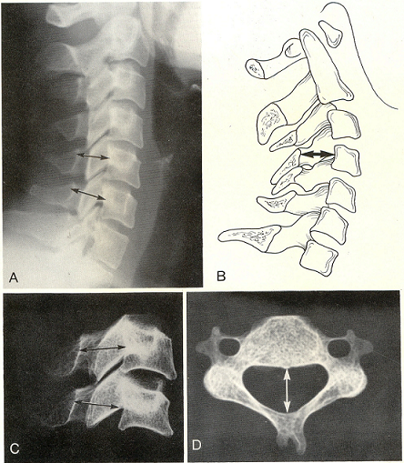
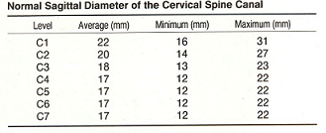
Sagittal dimension of the cervical spine canal

Slide 28
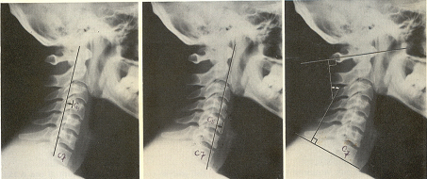
Cervical lordosis

Slide 29
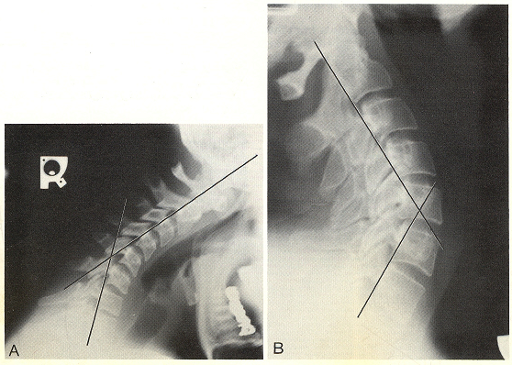
Stress line of the Cervical Spine
Posterior surface of the axis
Posterior surface of seventh
cervical body

