Slide 1

Chapter 10
AVR Timer Programming in Assembly and C
The AVR Microcontroller and Embedded Systems: Using Assembly and C
M. A. Mazidi
Dr. Seyyed Javad Seyyed Mahdavi

Slide 2
Contents
Programming Timers 0, 1, and 2
Counter Programming
Programming Timers in C

Slide 3
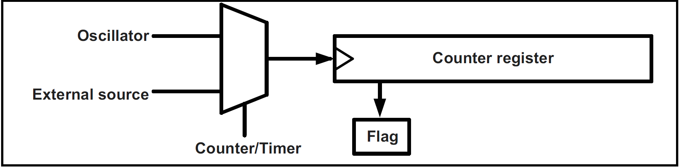
A General View of Counters and Timers

Slide 4
Programming Timers 0, 1, and 2
In ATmega32, there are three timers:
  Timer0, Timer1, and Timer2.
  Timer0 and Timer2 are 8-bit, while Timer1 is 16-bit.
Basic registers of timers
  TCNTn (Timer/Counter register)
  TOVn (Timer Overflow flag)
  TCCRn (Timer Counter control register)
  OCRn (output compare register)
  OCFn (output compare match flag)
  All of the timer registers are byte-addressable I/O registers
TCCRn
TCNTn
TOVn
=
OCFn
OCRn

Slide 5
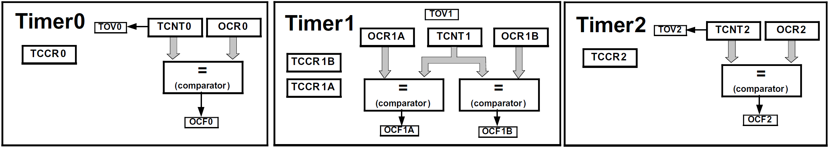
Programming Timers 0, 1, and 2
Basic registers of timers
Basic registers of timers
  TCNTn (Timer/Counter register)
  TOVn (Timer Overflow flag)
  TCCRn (Timer Counter control register)
  OCRn (output compare register)
  OCFn (output compare match flag)

Slide 6
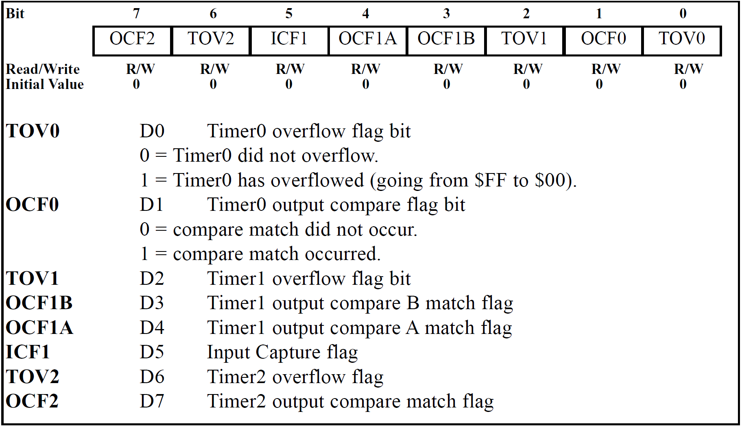
Programming Timers 0, 1, and 2
Basic registers of timers
TIFR (Timer/counter Interrupt Flag Register) register

Slide 7
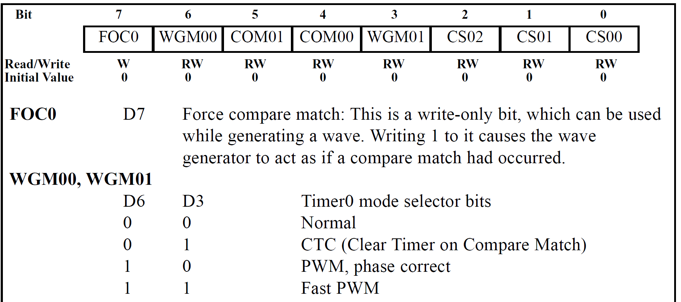
Programming Timers 0, 1, and 2
Timers 0 Programming
TCCR0 (Timer/Counter Control Register) Register

Slide 8
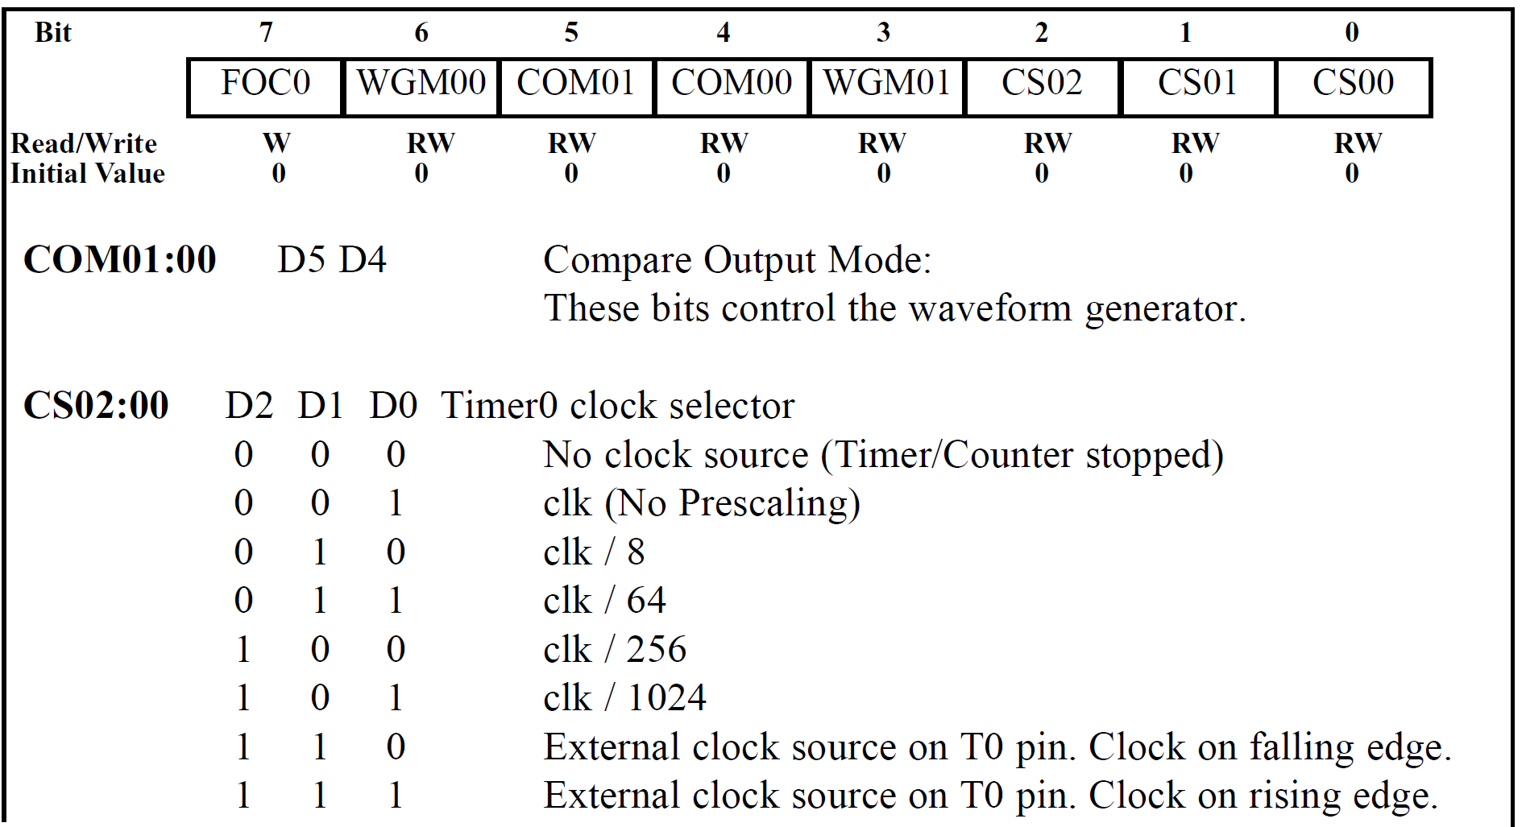
Programming Timers 0, 1, and 2
Timers 0 Programming
TCCR0 (Timer/Counter Control Register) Register

Slide 9
Programming Timers 0, 1, and 2
Timers 0 Programming
TCCR0 (Timer/Counter Control Register) Register

Slide 10
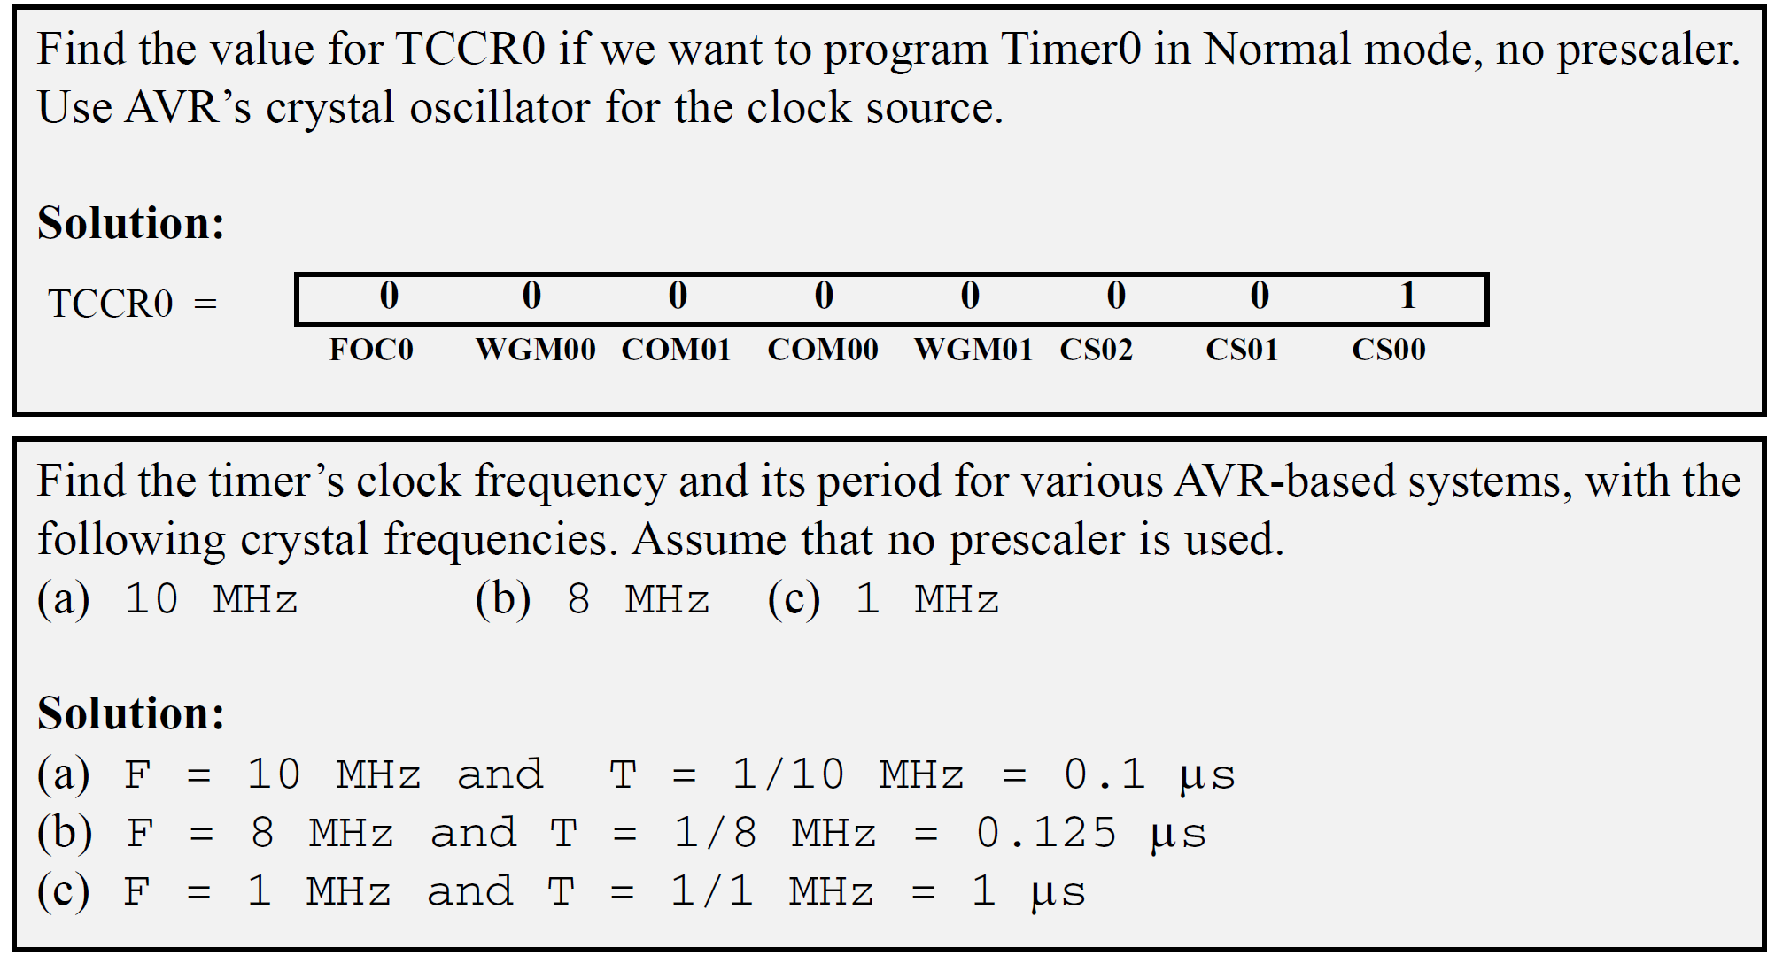
Programming Timers 0, 1, and 2
Timers 0 Programming

Slide 11
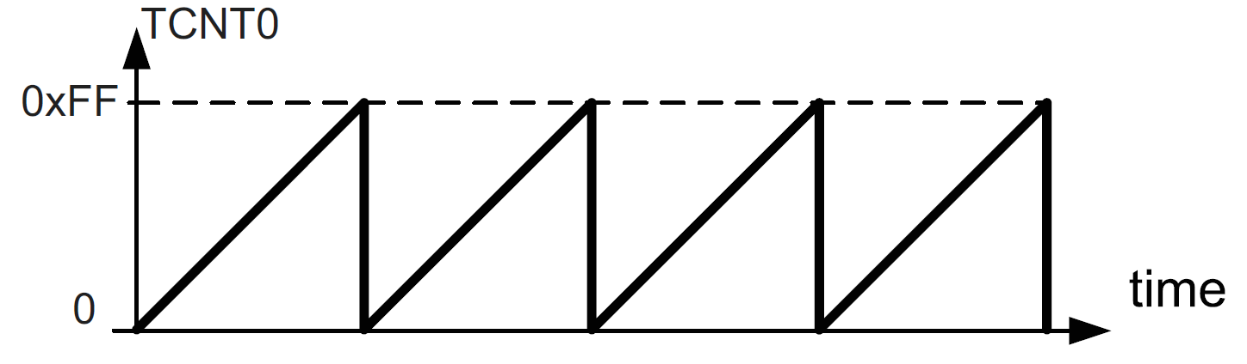
Programming Timers 0, 1, and 2
Timers 0 Programming
Normal mode
  When it rolls over from 0xFF to 0x00, it sets high a flag bit called TOV0.
Steps:
  Load the TCNT0 register with the initial count value.
  Load the value into the TCCR0 register which starts the timer
  Keep monitoring the timer overflow flag (TOV0) to see if it is raised.
    Get out of the loop when TOV0 becomes high.
  Stop the timer by disconnecting the clock source (following Instructions:)
  Clear the TOV0 flag for the next round.
  Go back to Step 1 to load TCNT0 again.

Slide 12
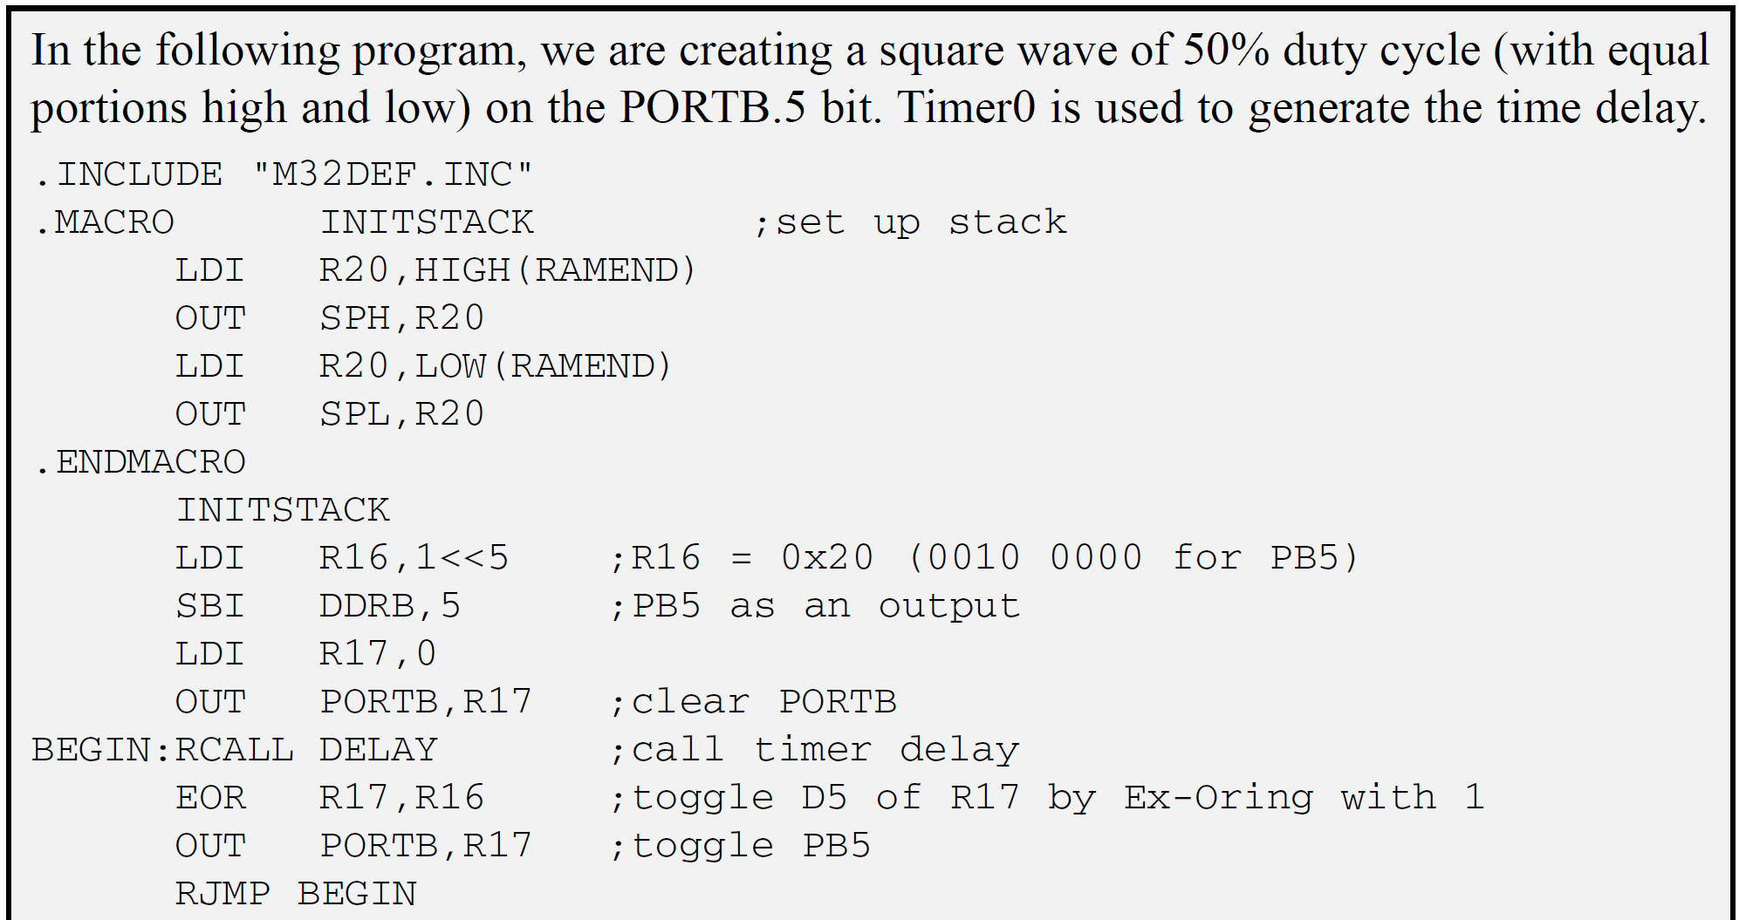
Programming Timers 0, 1, and 2
Timers 0 Programming

Slide 13
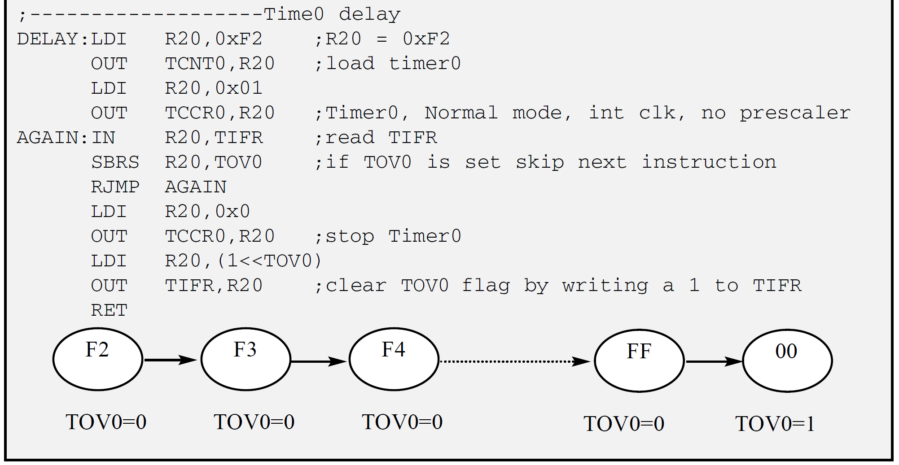
Programming Timers 0, 1, and 2
Timers 0 Programming

Slide 14
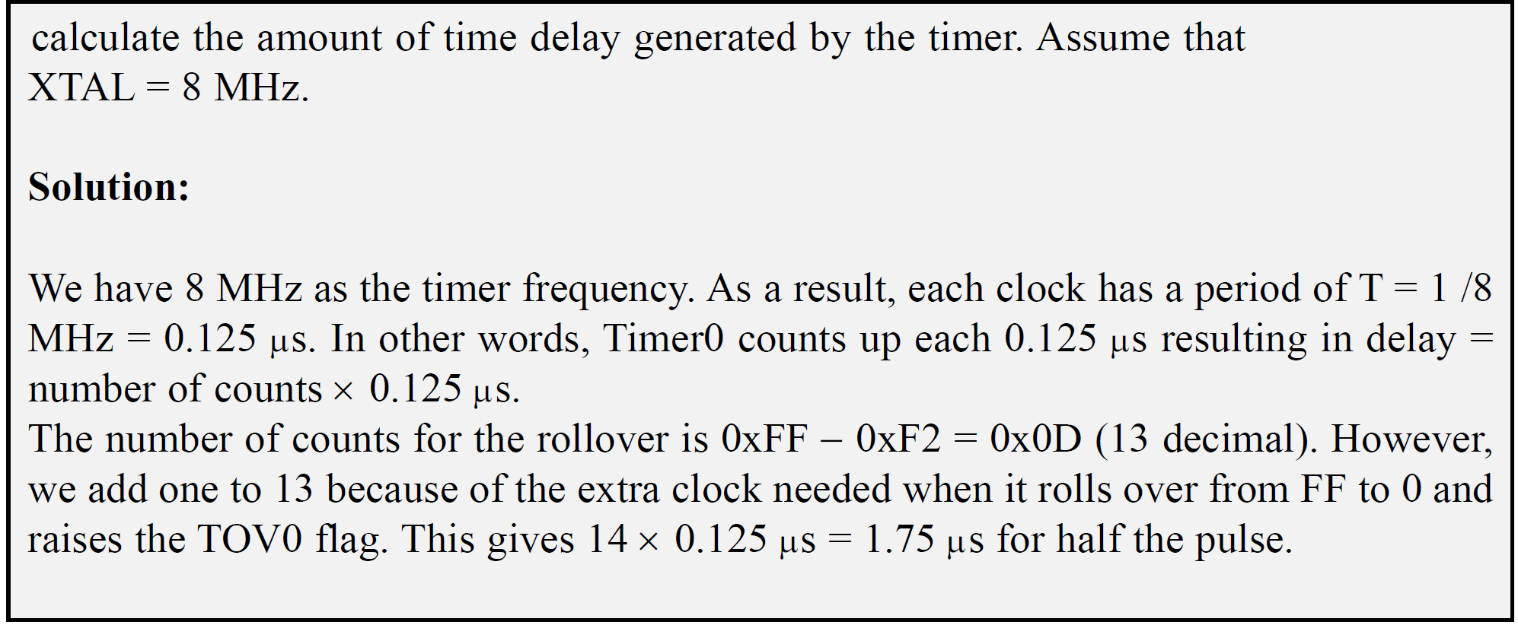
Programming Timers 0, 1, and 2
Timers 0 Programming

Slide 15
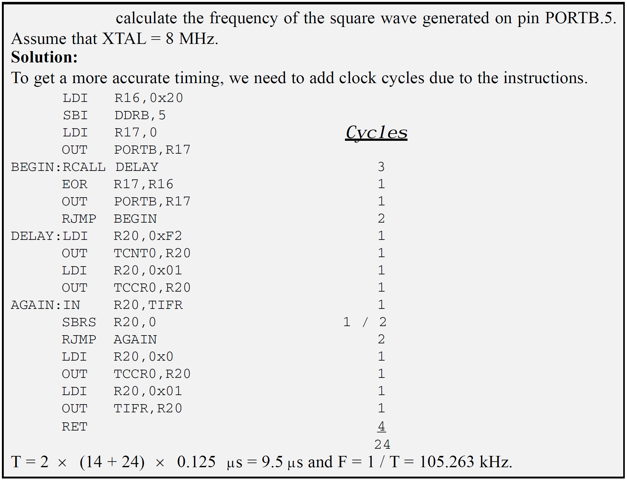
Programming Timers 0, 1, and 2
Timers 0 Programming

Slide 16
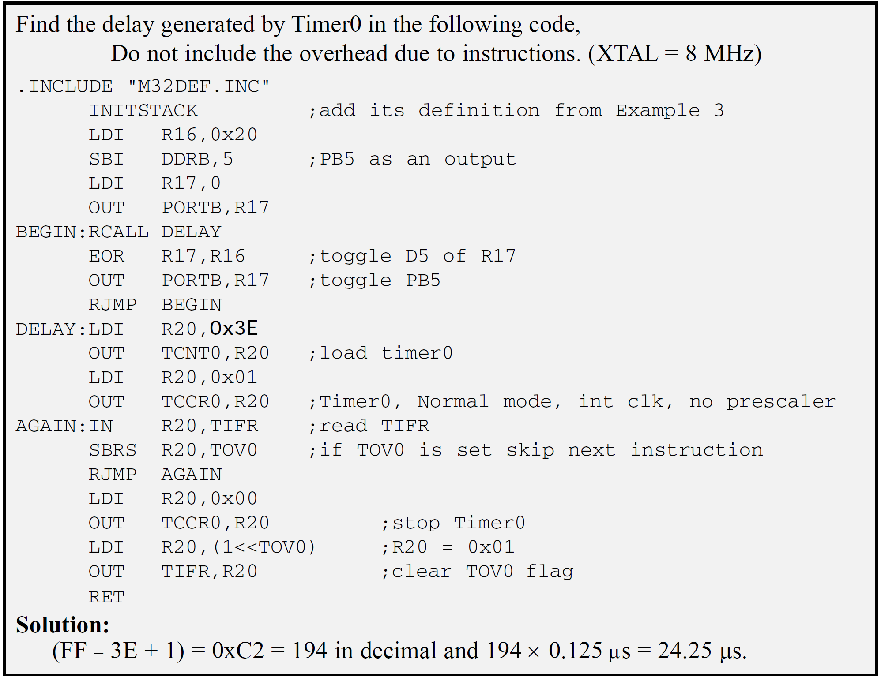
Programming Timers 0, 1, and 2
Timers 0 Programming

Slide 17
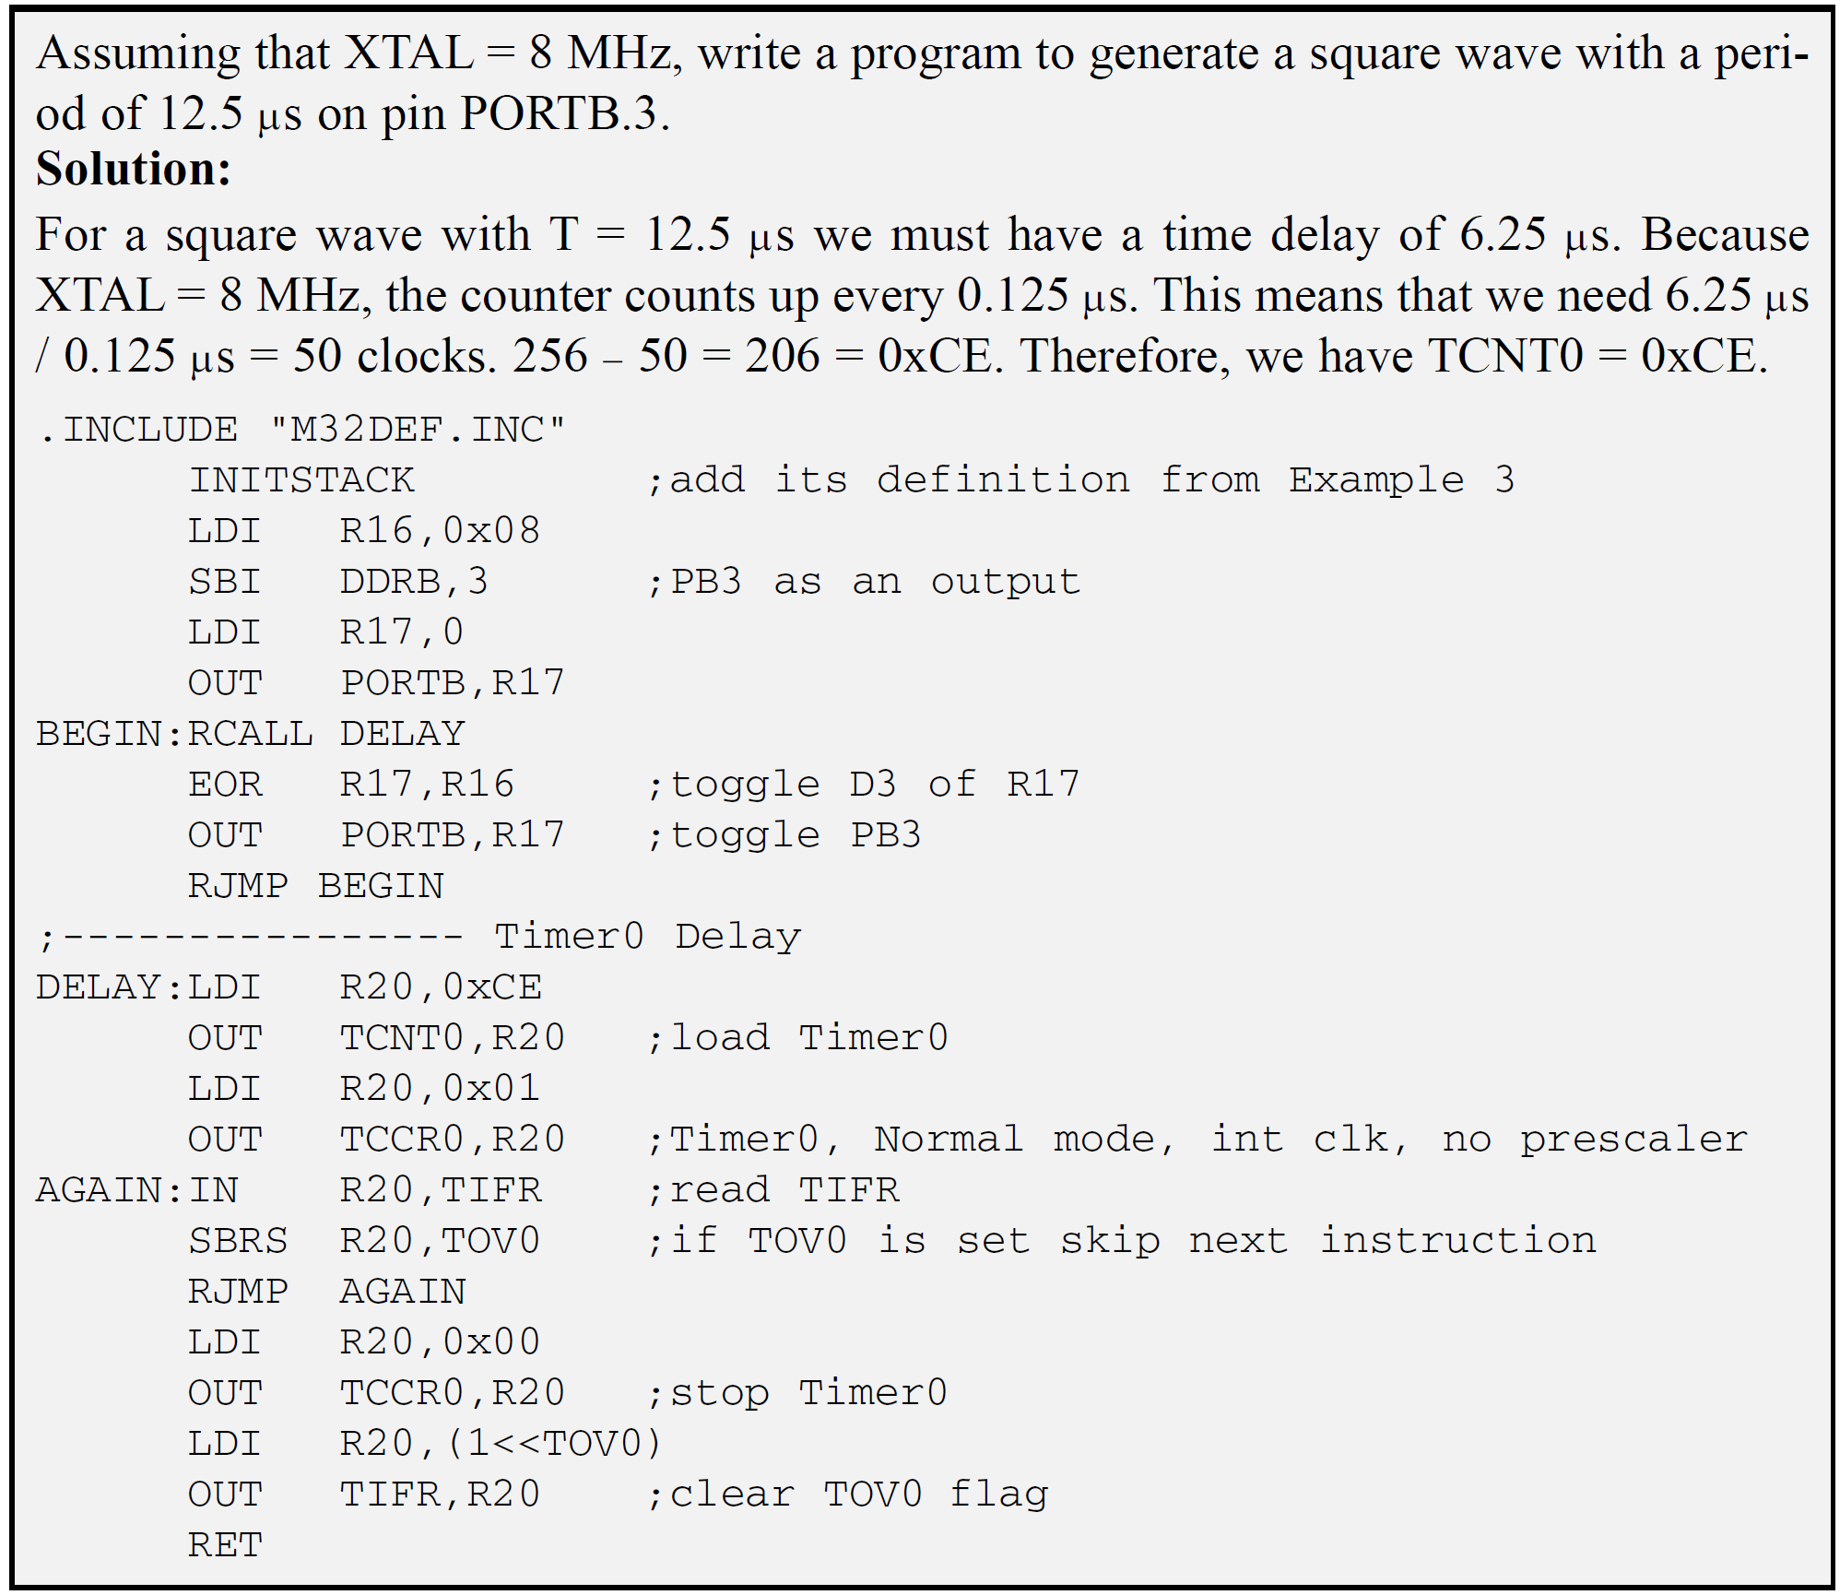
Programming Timers 0, 1, and 2
Timers 0 Programming

Slide 18
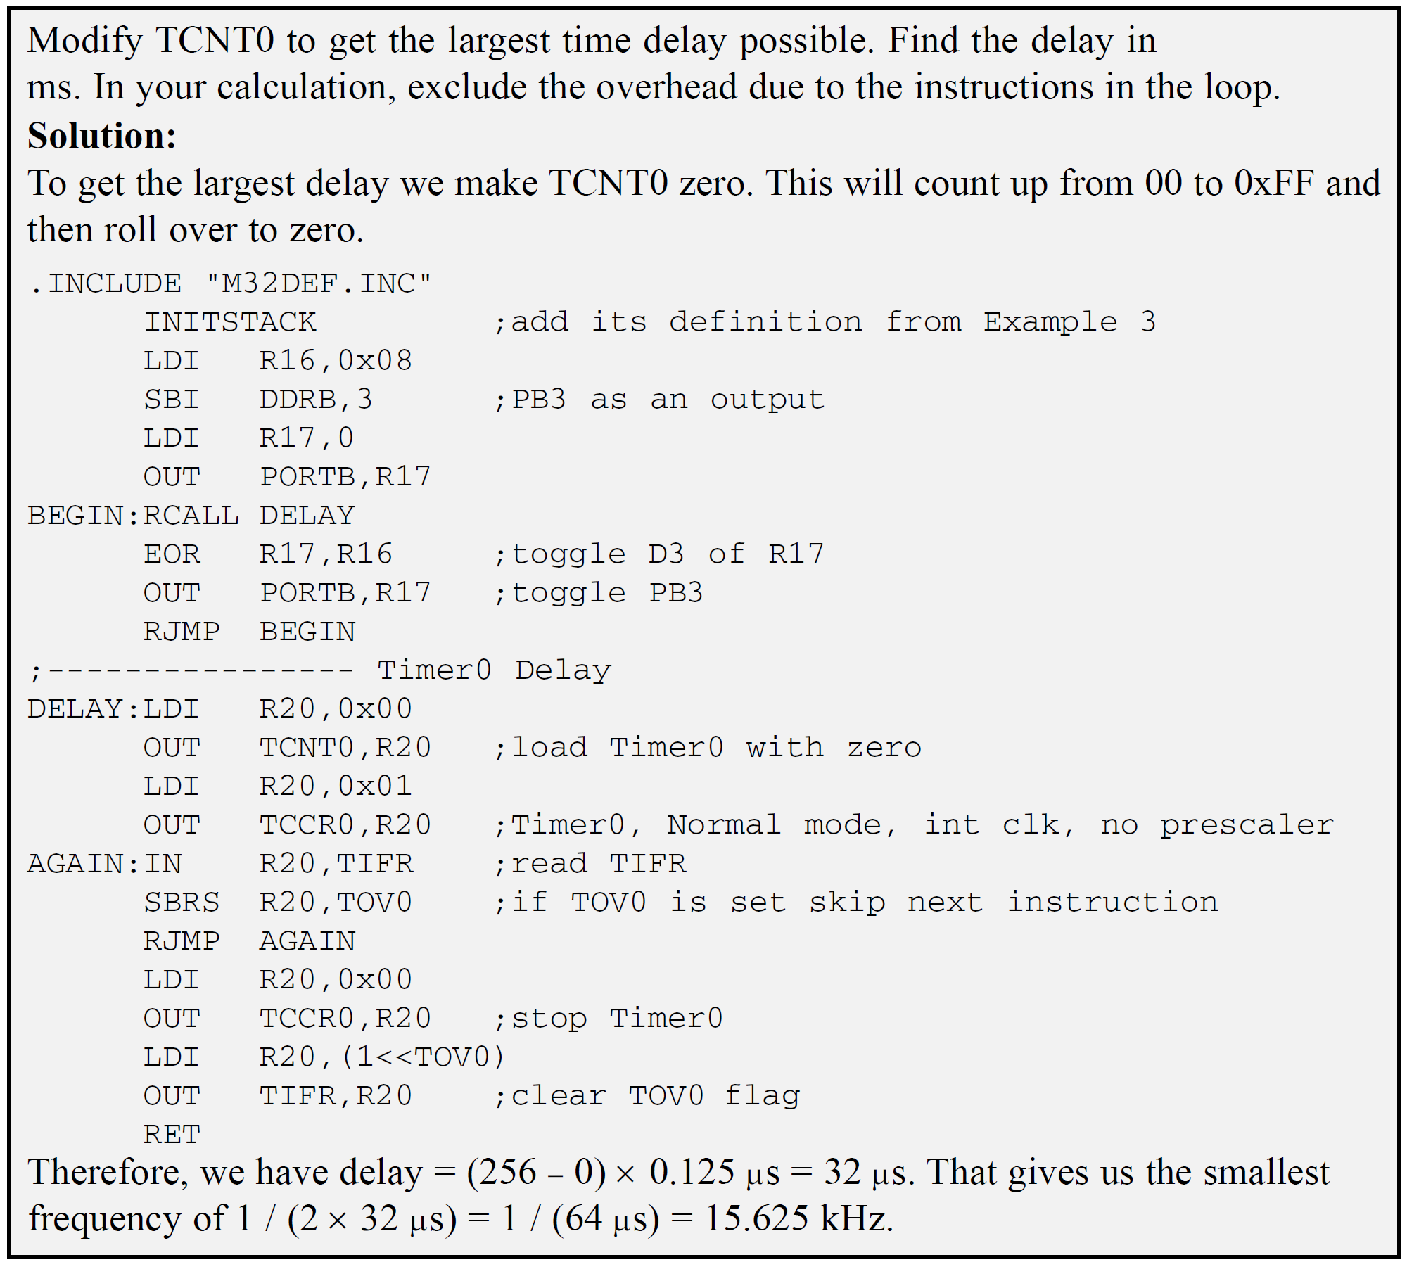
Programming Timers 0, 1, and 2
Timers 0 Programming
Maximum delay in normal mode without Prescalar

Slide 19
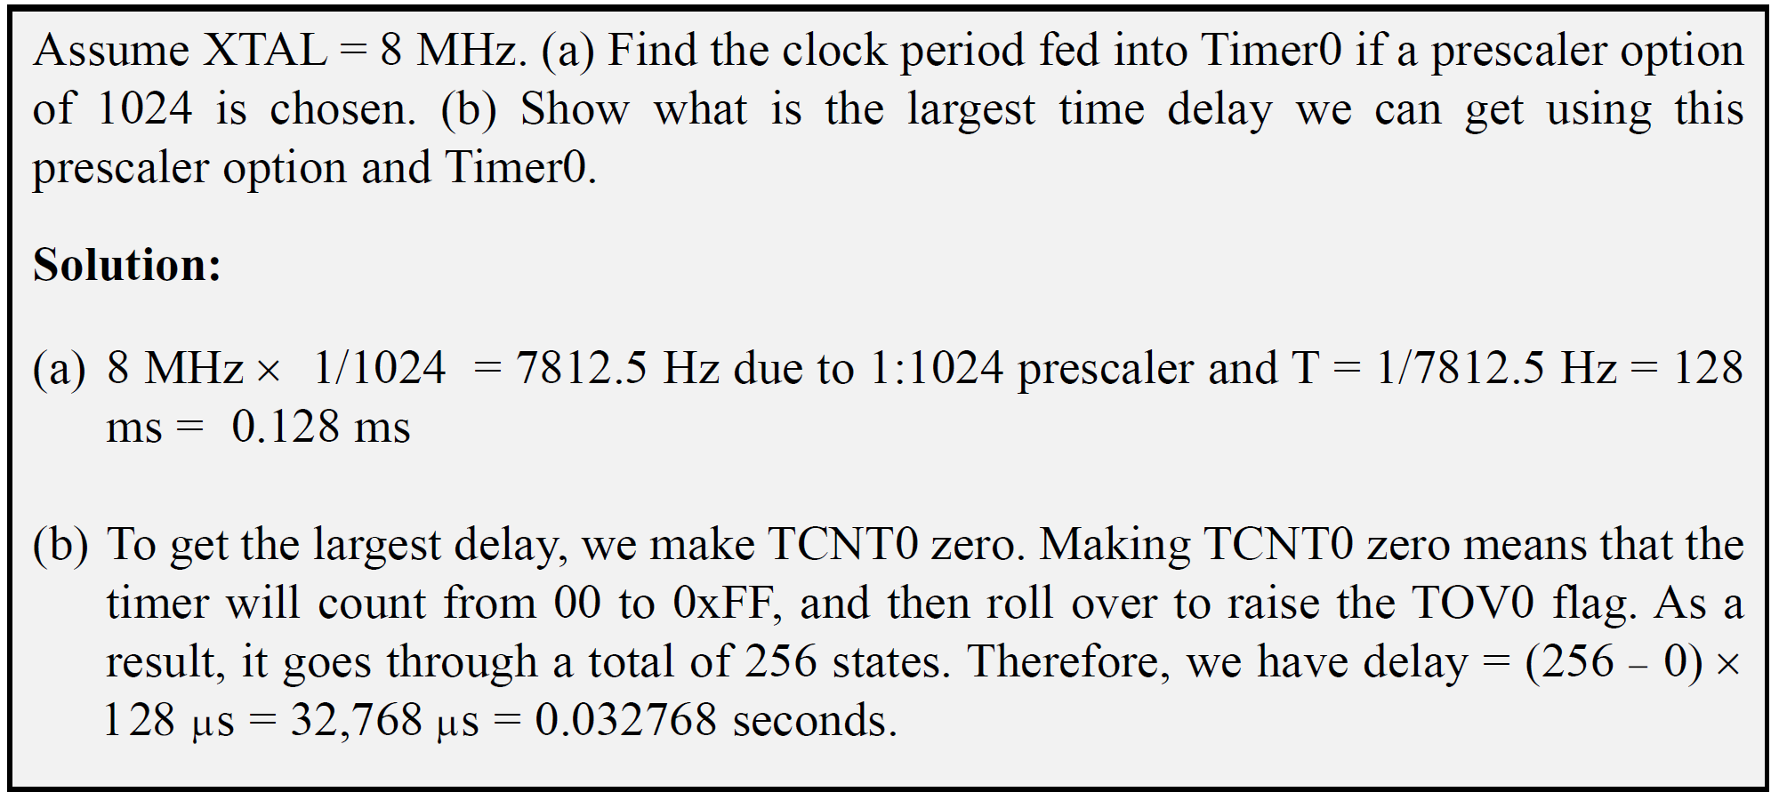
Programming Timers 0, 1, and 2
Timers 0 Programming
Maximum delay in normal mode without Prescalar

Slide 20
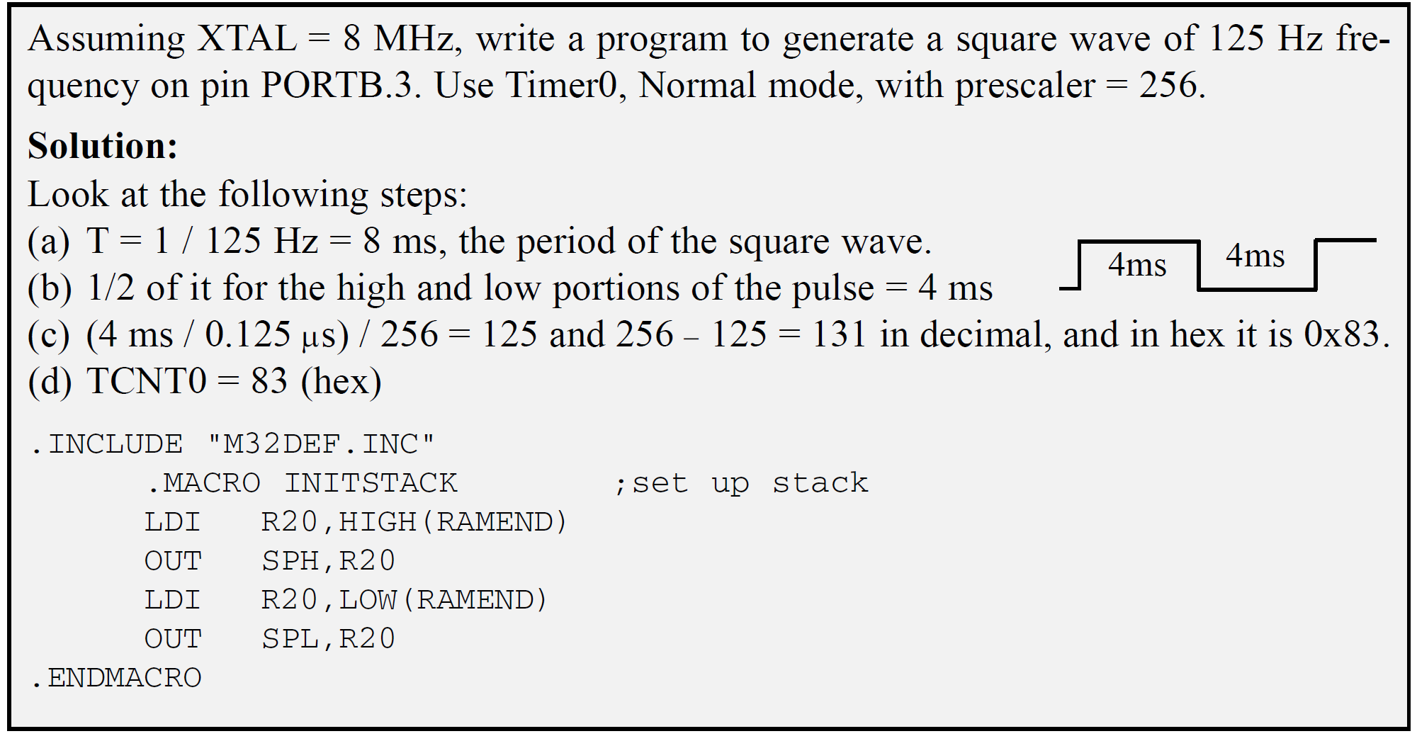
Programming Timers 0, 1, and 2
Timers 0 Programming
Maximum delay in normal mode without Prescalar

Slide 21
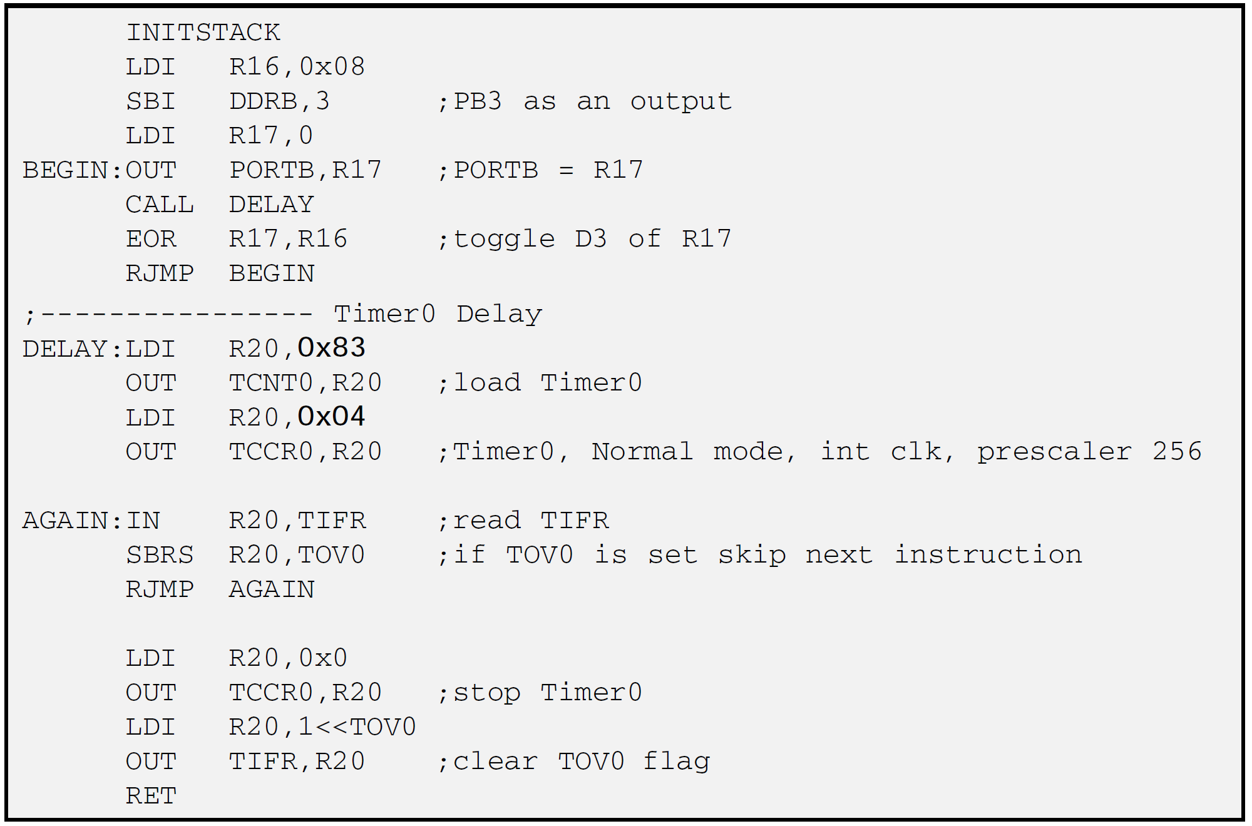
Programming Timers 0, 1, and 2
Timers 0 Programming
Maximum delay in normal mode without Prescalar

Slide 22
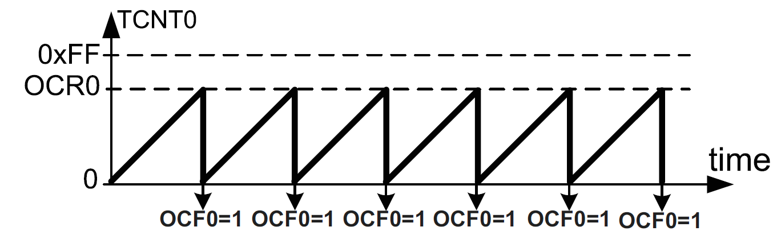
Programming Timers 0, 1, and 2
Timers 0 Programming
Clear Timer0 on compare match (CTC) mode programming

Slide 23
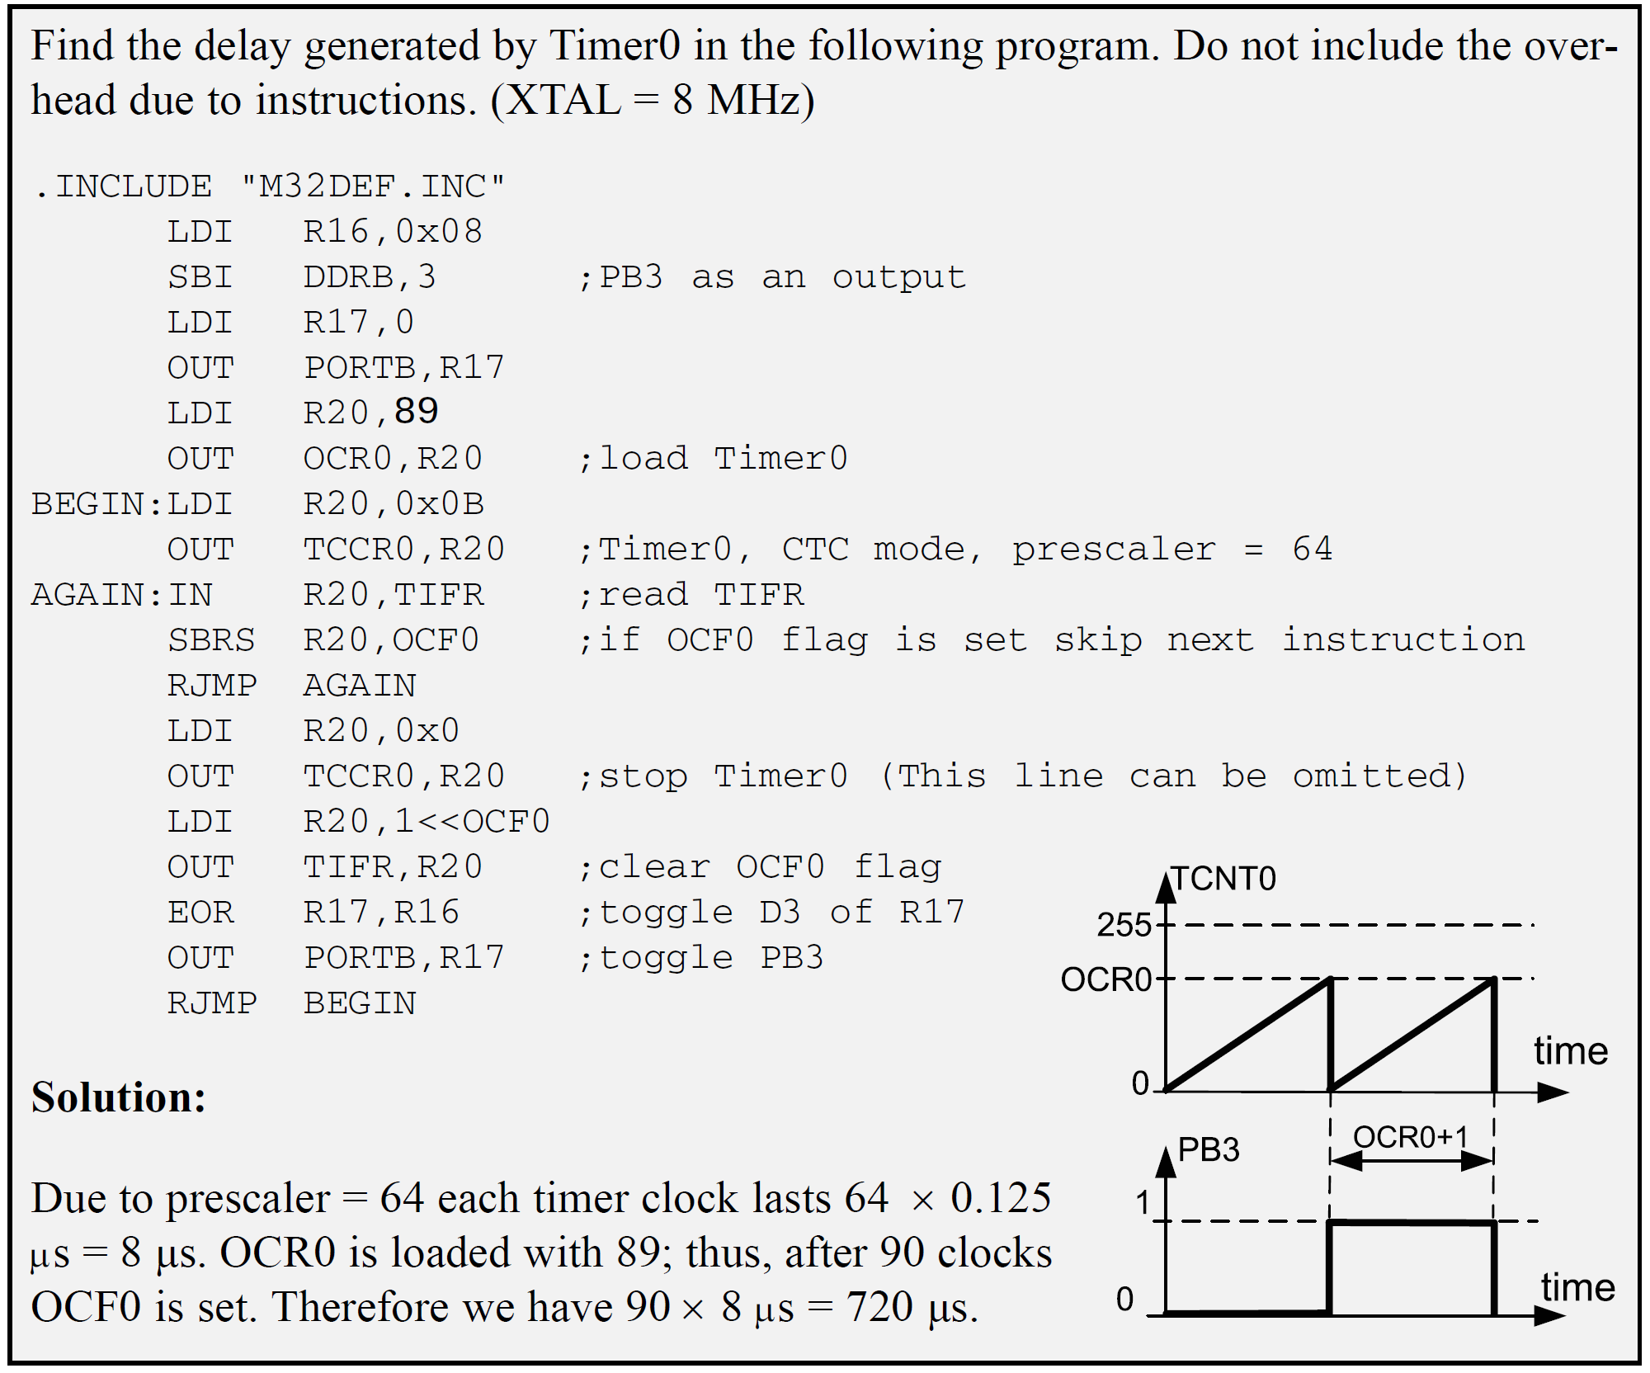
Programming Timers 0, 1, and 2
Timers 0 Programming
Clear Timer0 on compare match (CTC) mode programming

Slide 24
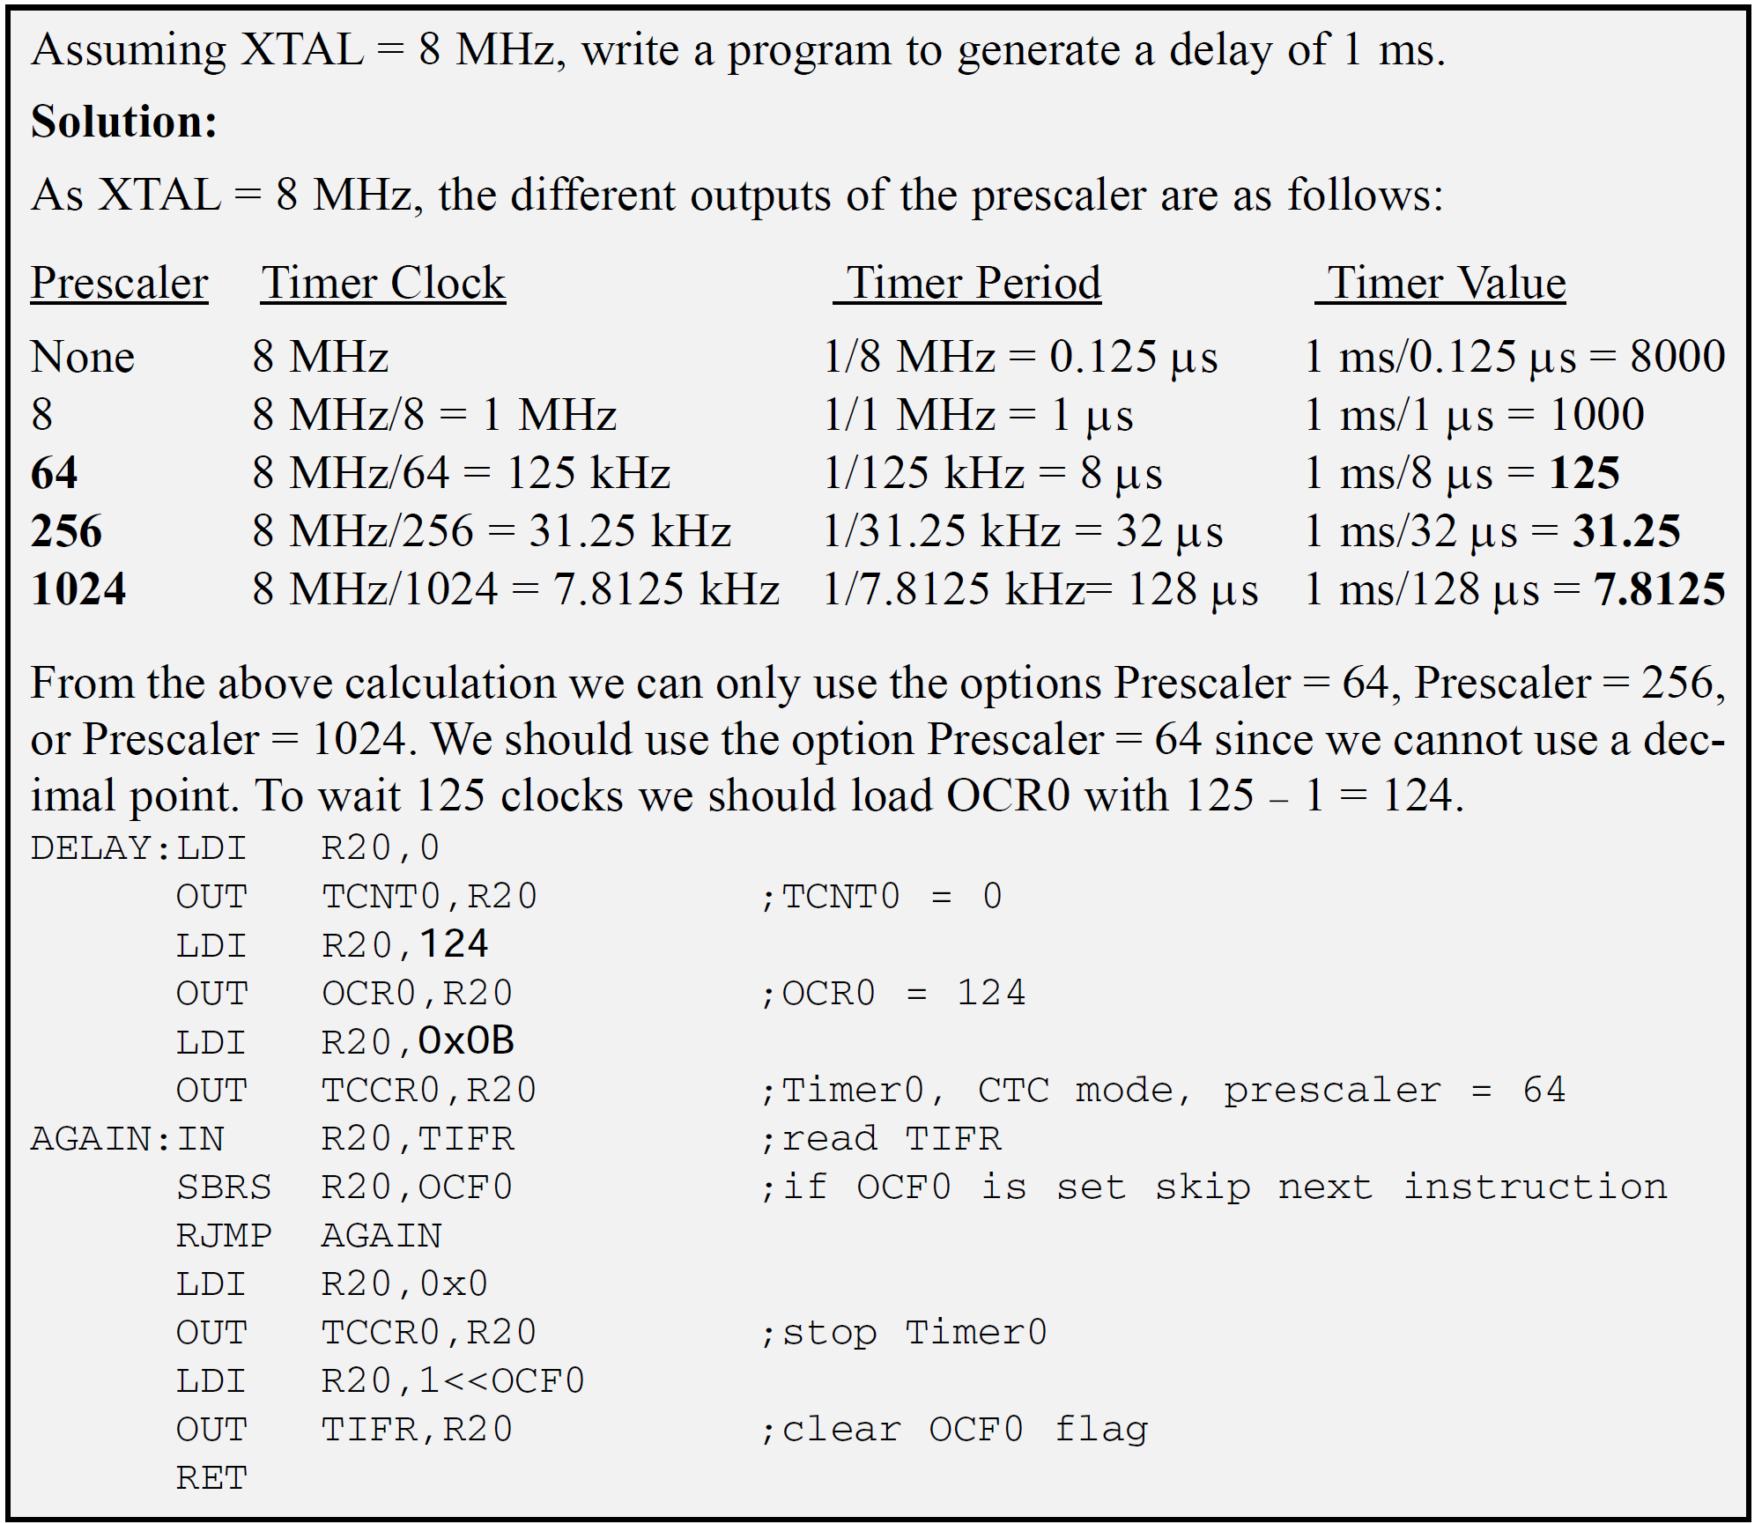
Programming Timers 0, 1, and 2
Timers 0 Programming
Clear Timer0 on compare match (CTC) mode programming

Slide 25
Programming Timers 0, 1, and 2
Timers 2 Programming
Timer 0
Timer 2
CS02 CS01 CS00 Comment
0 0 0 Timer/Counter stopped
0 0 1 clk (No Prescaling)
0 1 0 clk / 8
0 1 1 clk / 64
1 0 0 clk / 256
1 0 1 clk / 1024
1 1 0 External clock (falling edge)
1 1 1 External clock (rising edge)
CS22 CS21 CS20 Comment
0 0 0 Timer/Counter stopped
0 0 1 clk (No Prescaling)
0 1 0 clk / 8
0 1 1 clk / 32
1 0 0 clk / 64
1 0 1 clk / 128
1 1 0 clk / 256
1 1 1 clk / 1024

Slide 26
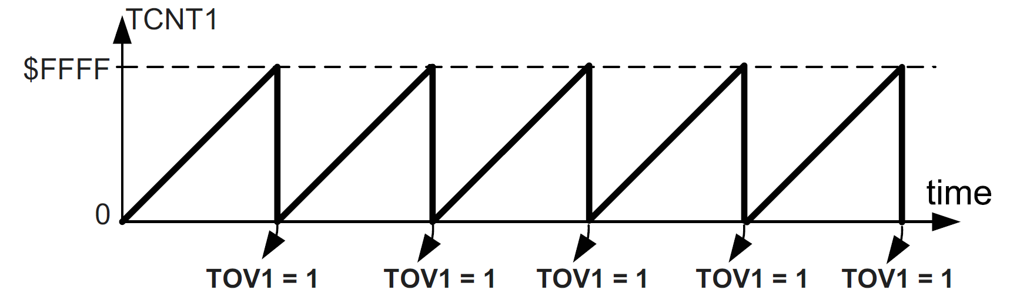
Programming Timers 0, 1, and 2
Timers 1 Programming
More complicated

Slide 27
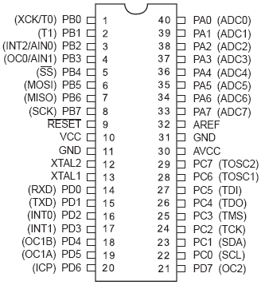
Counter Programming
For Timer 0
  when CS02:00 is 6 or 7,
  the TCNT0 counter counts up as pulses are fed from pin T0
For Timer 1
  when CS12:10 is 6 or 7, the clock pulse coming in from pin T1 makes the TCNT1 counter count up.
  6, the counter counts up on the negative (falling) edge.
  7, the counter counts up on the positive (rising) edge.
T0

Slide 28
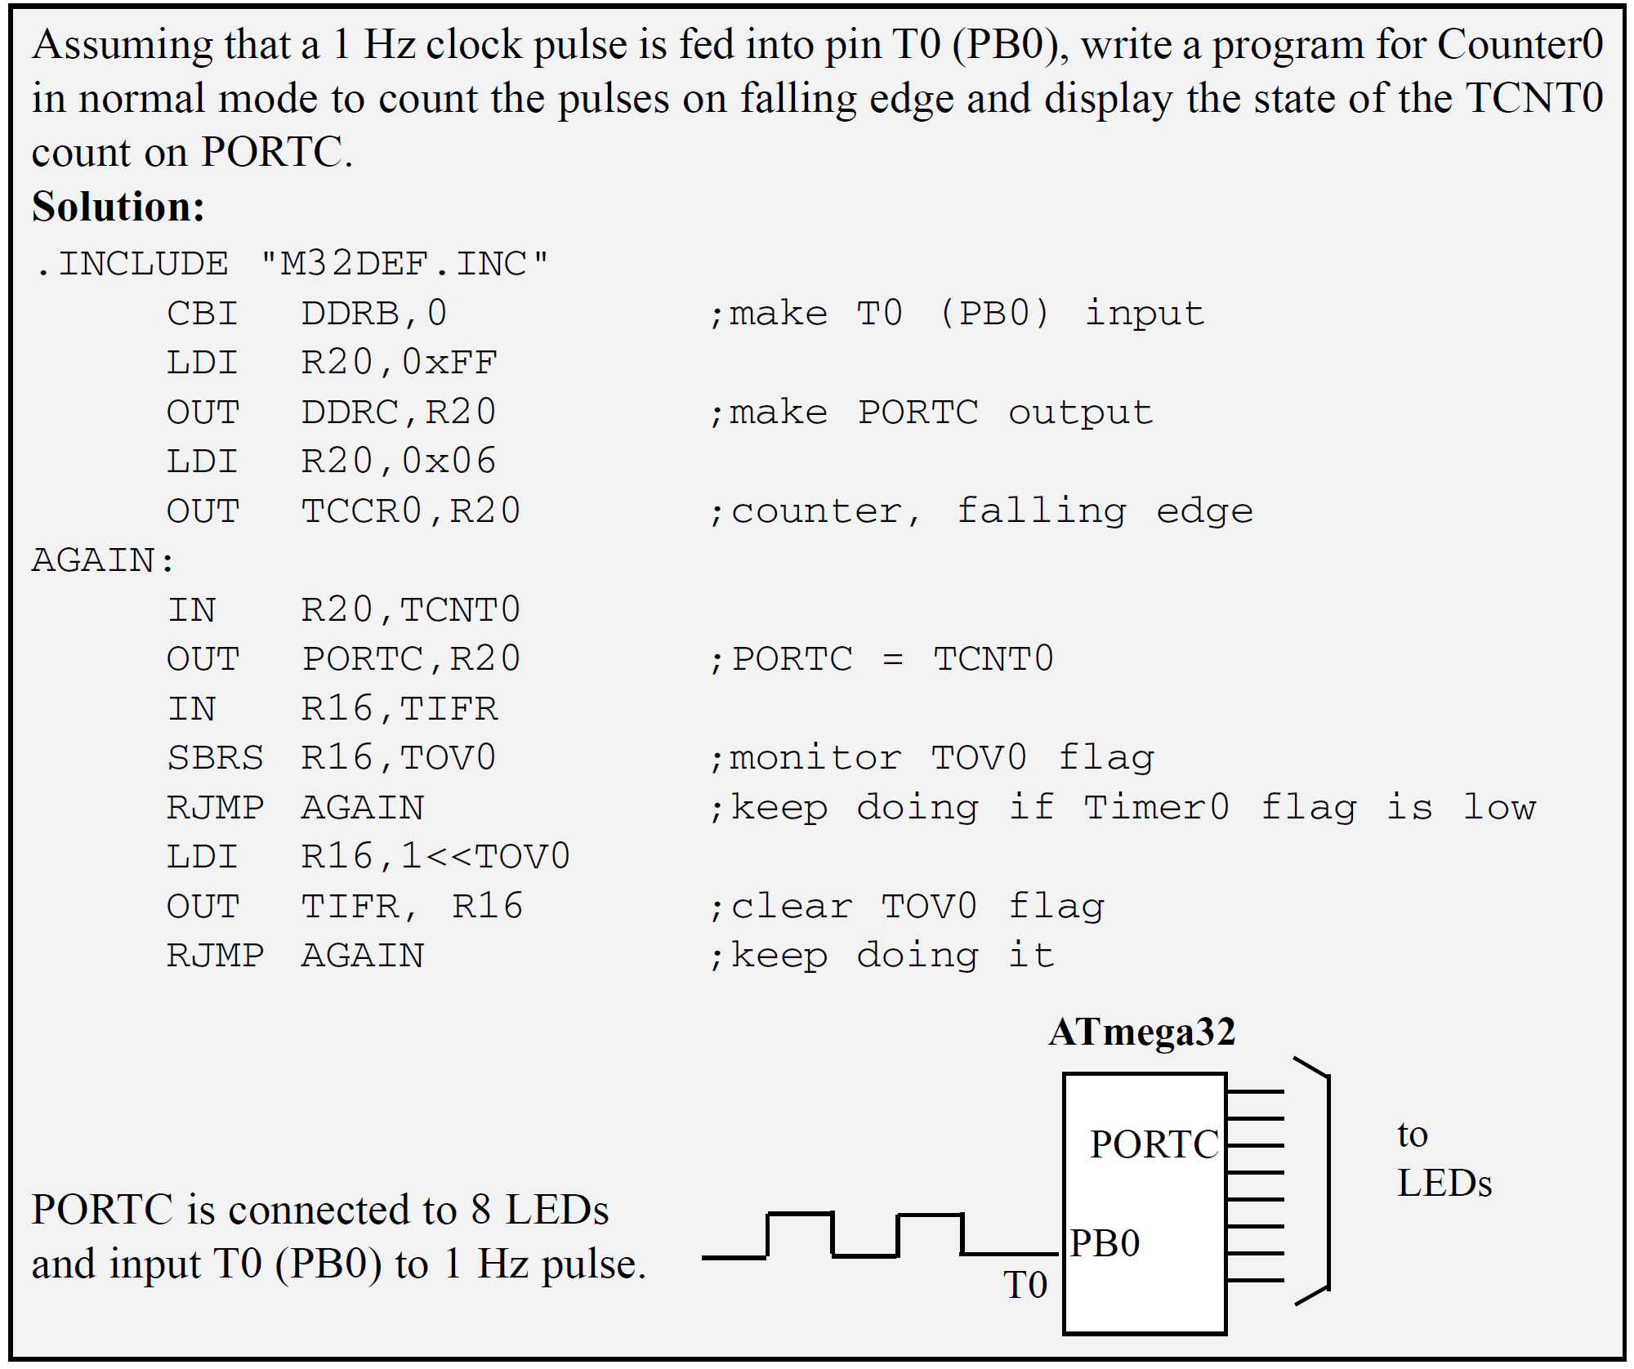
Counter Programming

Slide 29
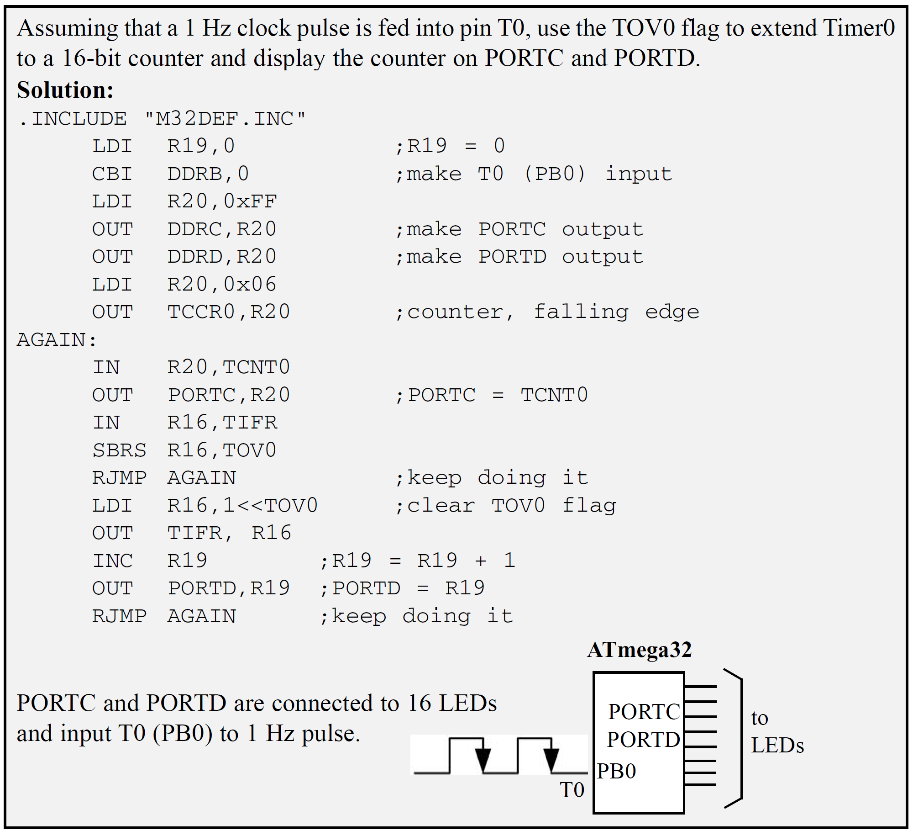
Counter Programming

Slide 30
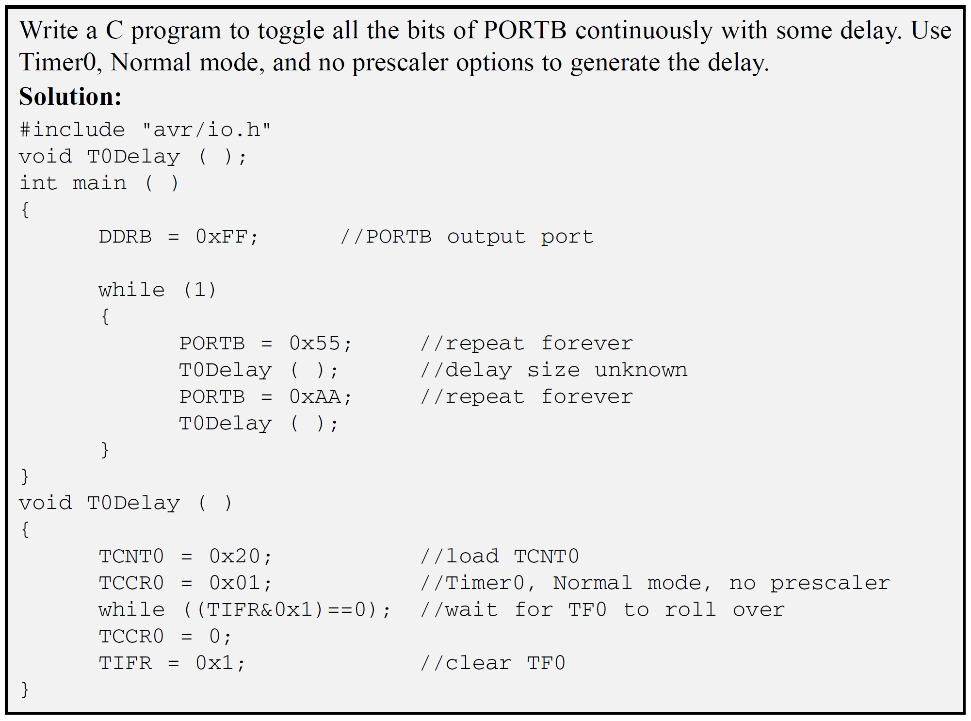
Programming
Timers in C

Slide 31
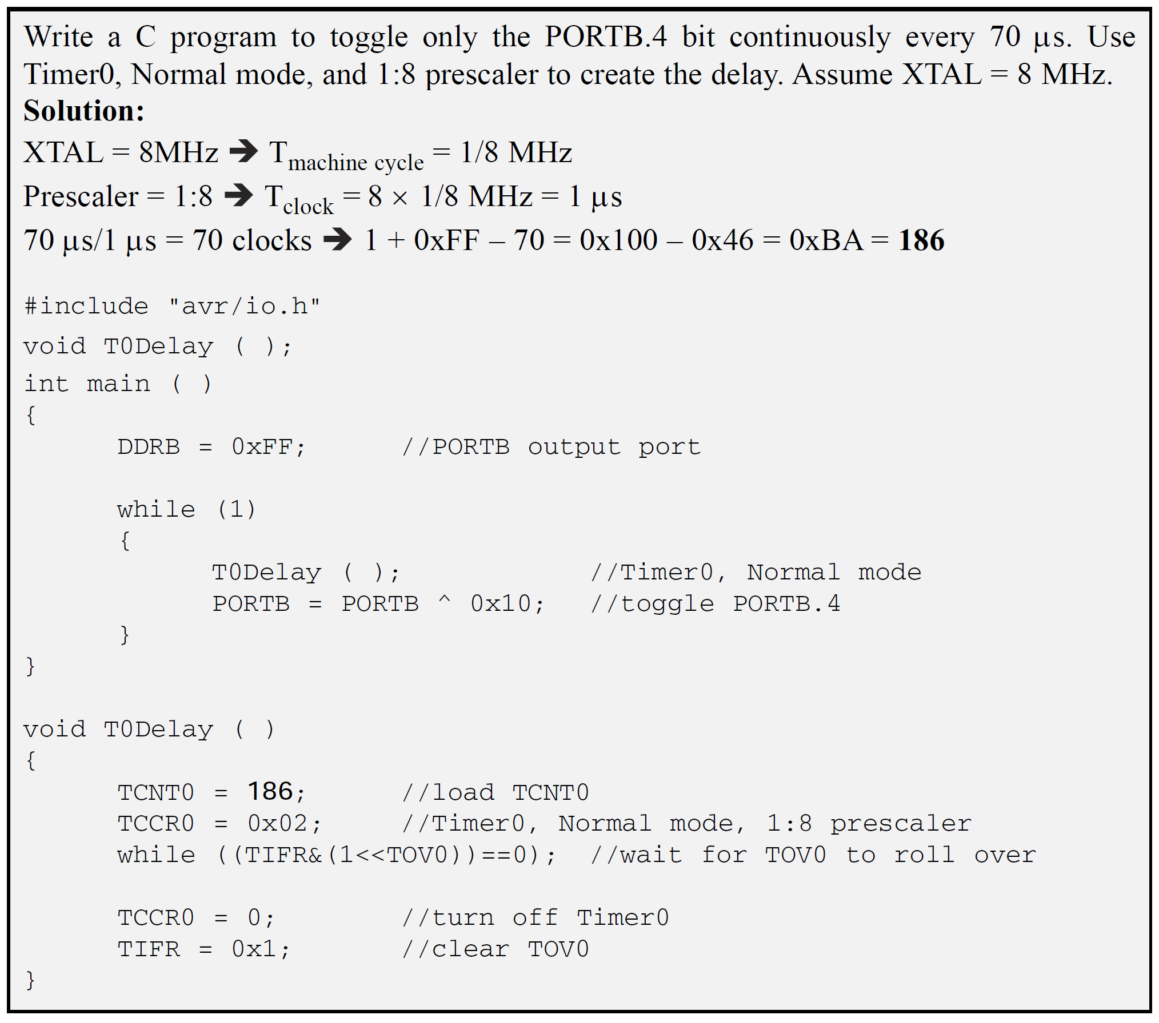
Programming
Timers in C

Slide 32
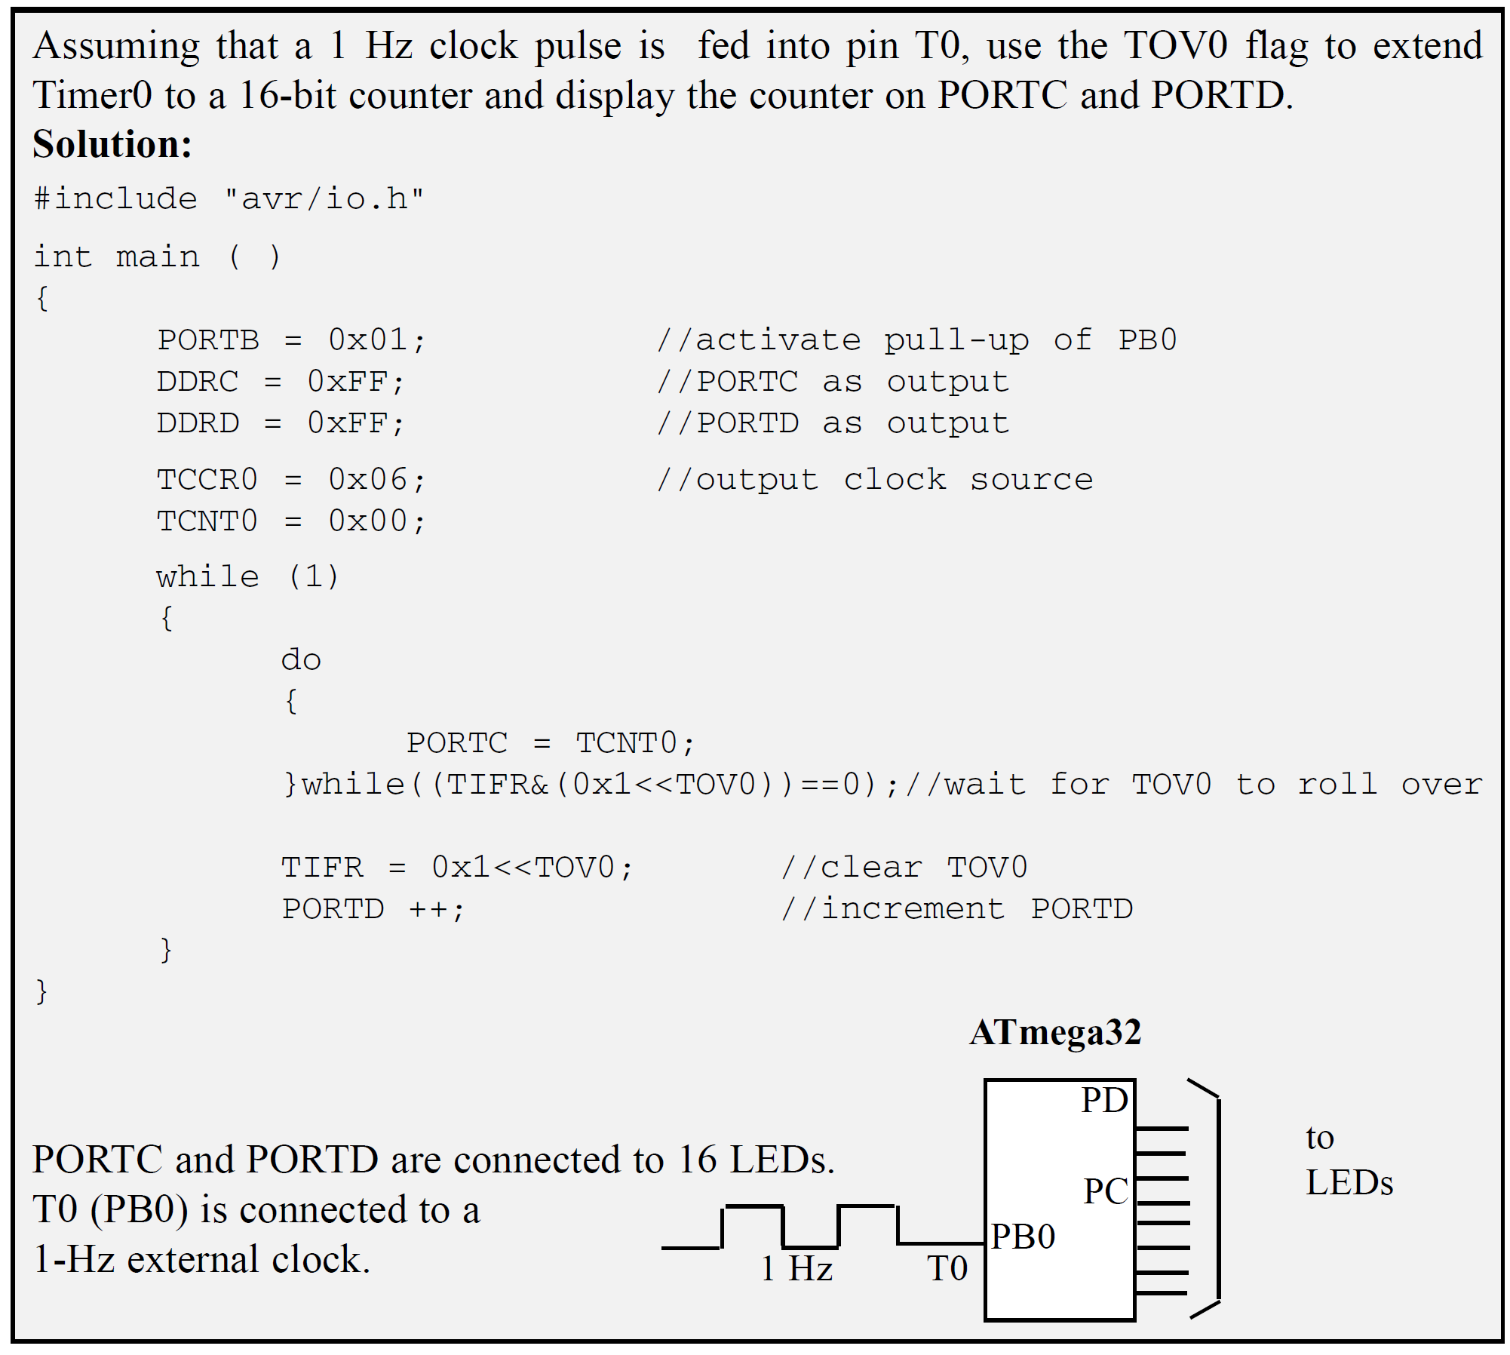
Programming
Timers in C

Slide 33
Problems

