Slide 1
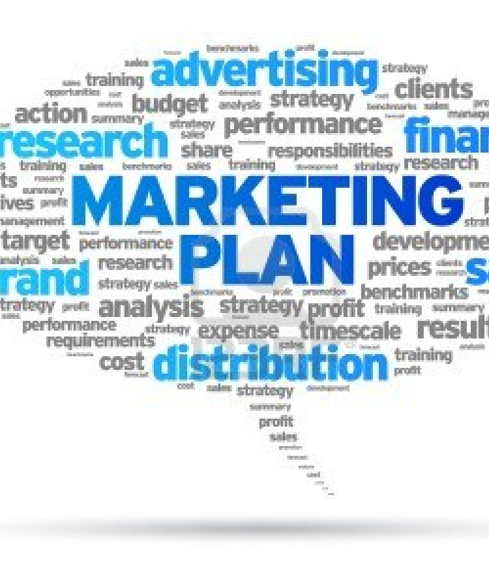
Strategic Marketing Management in an International Context. [7mark020w]
CW2- Final Assignment Debrief

Slide 2
(Layout]:
Include:
Cover page
Table of contents [do it automatically]
1.0- Introduction
The general structure should follow the brief:
Part A: Audit
Internal
External
Part B: Strategic Mktg Plan
Executive Summary
SWOT
Marketing Objectives
Marketing Strategy

Slide 3
Where are we
?
Where do we want to be
?
How do we get there
?
What do we do well, or badly, compared to our competitors?
Internal
Audit
Product
strategy
Price
strategy
Promotion
strategy
Place
strategy
S
W
Marketing Strategy
STP/
Key Issues
Marketing Objectives
O
T
What, in the external business or global environment, might make it easier or harder for us to achieve our objectives?
External
Audit

Slide 4
Introduction
Include a brief Introduction: Not more than 100 words.
You should also indicate clearly what is the scope of your audit.
Is it Global,
or are you looking at 1 or 2 specific countries
If so, please identify these as your audit[especially the External audit] should focus on issues that ‘specifically’ concern these countries/markets.

Slide 5
[1] Internal Audit
use various theories and tools to examine key areas such as:
Include general company issues such as finance[including trends over several years], quality of managers, other staff, HR issues,, tech capability, reputation,
Ultimately it’s about the marketing mix [dedicate the most word count to this].
Which includes such things as product portfolio & PLC’s, brand name, brand equity, pricing, promotion and distribution. Don’t forget to include service related issues if these are relevant.
Draw key significant comparisons with competitors marketing mix.
Support your situational analysis with strong research sources where possible.
Include some financials on competitors- establishing trends here will help identify gaps and ‘what you can, and cannot do’
Notes:
The internal audit will look at various aspects such as:
Company issues might include the following:
Sales [total by geographical location, by industry type, by customer, by product,
Market share,
Profit margins,
Marketing procedure, organisation, and sales/marketing control information.
Marketing mix variable to consider [current]:
Market research,
Product development, range and quality,
Unit sales, stock levels
Distribution, dealer support,
Pricing, discount, credit.
Promotion [Digital & traditional]: Including packaging, samples, exhibitions, selling, sales aids, point-of -ale, advertising, sales promotion, PR, after sales service & training.
Operations & resources[Current]- you might consider some of these question where possible, and where relevant:
Marketing objectives: Are they clearly stated and consistent with marketing & corporate objectives?
Marketing Strategy: What is the current marketing strategy and are there sufficient resources to meet these objectives across the marketing mix?
Structure: How is the marketing function structured: along functional, product, end user or territorial lines?
Information System: Is the marketing intelligence system producing accurate and timely intelligence in the marketplace?
Planning system: Is the marketing planning system well conceived and effective?
Interfunctional efficiency?: Are there any problem between marketing and other corporate functions? Is there a question of ‘centralised versus decentralised’ marketing in the company?
Profitability analysis: Is the profitability monitored by product, served markets, etc to assess where the best profits and the biggest costs of the operation are located?
Cost- effectiveness analysis: Do any current marketing activities seem to have excess costs? Are these valid or could they be reduced?
There are many paradigms which can be used here, but some of the most useful insights will come from the PLC & portfolio matrix. This should help you identify how the portfolio will change in the future. [Don’t forget that that there are other tools which we have explored and which will also deliver some insights.

Slide 6
[2] External Audit.
The main focus here is on Macro & Micro issues:
MACRO:
You should NOT be talking about the company under study at all, but instead focus on the issues affecting the INDUSTRY in which they operate.
This is a market-centred analysis.
What you are searching for here are ‘unmet customers needs and wants’
It’s preferable not to explicitly use PEST although many of the issues will fall under the various categories.
Identify only the main issues
Include data and evidence
Frame the conclusions of ‘each issue’ as an opportunity or a threat:
Identify what the likely impact on the industry will be.
Try to prioritise these: there will be many issues, but what are the ‘most important’? Can you rank them in order of importance or opportunity?
Micro
Should also include key industry trend[s][micro issues] eg; changes in industry structure.
Key competitors and trends eg: in growth, etc
Look at opportunities to expand:
look at gaps and possible market opportunities.
May be country or regions
Notes:
As you carry out your marketing audit, you should be concerned only with the issues that affect your business/markets.
Macro Environment: Firstly to examine the macro environment, you should be guided by the PEST framework, but I advise against explicitly using it: Too often, students follow this through religiously and therefore waste time and valuable wordcount identifying insignificant or largely irrelevant issues. You should only be concerned with aspects that are ‘or are likely ‘ to affect the business environment now or in the future.
Market/market potential: You should look at the market[or potential market], its size, growth and trends &, characteristics. Included in this, you might look at products, prices, physical distribution, channels, customers/consumers, communication and industry practices.
The competitive environment: Consider such things as: Industry profitability, the major competitors [& perhaps rapidly growing new entrants], size, market share, market standing/reputation, production capabilities, distribution policies, marketing methods, extent of diversification, international links, profitability and key strengths and weaknesses.

Slide 7
Trend & Emerging Issues [example London Taxi MACRO Environment: 2019] This is a way of visualising the Macro Environment: Key sub-headings have been used which are not PEST headings…although they generally do fall under these areas. It is NOT an expectation to produce a table like this, although you can if you wish, but you still need to include a normal narrative, and this table should NOT replace that: As you can see, below , there are 6 core sub-headings which summarise the macro audit.
Emerging Issue | Fact | Implication[Effect] | Opportunity [+5 to +1] (Positive/plus) Threat [-5 to-1] (Minus/Negative)
Increased disposable income Urbanisation | Couples getting married later, Declining birth-rate(1.8 per couple) (Mintel, 2017) 82.84 percent of the total population in the United Kingdom lived in cities (Statista, 2018) | Higher discretionary income for socialising and comfort travel. Growing urban market which is suited to taxi business. | +4 +3 [but higher in more congested cities]
Disruptive Technologies | Development of smart: technology integrating GPS; payment security; safety systems (TechTarget, 2017) | Allowing for easy tracking & payment of trips, greater sense of safety by passengers(Females) | +4
Regulation: | TFL stepping up on regulating taxi business. (The Economist, 2018) | Devastating for business: Business licences may be withdrawn | -5
CO-2 | Increased concern regarding the environment. (Gov.UK, 2018) | Resulting in restrictions on # of taxis: traffic curtailment exercises in London/other cities. Likely to result in increased fares & resulting decline of market. | -3
Brexit | Growing GDP (ONS, 2018), but storm clouds arising from BREXIT: Inflation outpacing wage increases. | Impacting negatively on discretionary incomes: taxi trips are likely to take the first hit. | -2

Slide 8
(3) The Executive Summary
This should be the last thing that you will write.
Note
it is not positioned at the start of your report!!!!
Needs to be concise yet comprehensive and persuasive.
Should explain:
what needs to be achieved,
how it will be achieved, and at what cost;
what obstacles there may be and how they will be overcome.
Break it down into 3-4 paragraphs

Slide 9
(4) SWOT
Based on both audits
O+T: External-identifying macro & micro points which will have identified possible gaps or opportunities/threats to consider
S+W: Internal-aspects of the company and its marketing mix.
Firstly, start by summarising the key bullet points in a SWOT table: [bullet points only]
it is usual not to have more than 3 points for each S-W-O-T, so think very carefully about this.
You need to prioritise.
It should cover all points with no extraneous material under any of the four SWOT headings.
Secondly, [and after the above], you should summarise clearly the key issues that need to be addressed which you will have drawn from both the external and internal audits. These are NOT all the issues, but the issue your organisation should plan to address.
This should flow naturally from the external & Internal audit. If this is not the case, you need to return to your audits and update them.
NO new research should appear in the SWOT: You have done all your research that will help form objectives in the audits.
These should lead into the objectives which you will identify in the next part.
Notes:
Once you have completed the audit, the next task is to summarise it in a cogent and interesting analysis of each major segment.
In simple terms, you should be able to identify:
Your company’s differential strengths vis-à-vis your competitors
Where the best opportunities exist, i.e. market segments.
The present and future threats in these market segments.
Some of the most useful insights will come from the PLC & portfolio matrix which should help you identify how the portfolio will change.
Some guidelines for creating a meaningful SWOT: ensure that:
Strengths should create value for the organisation/customer and should be unique, inimitable and lasting.
Weaknesses should be meaningful to customers, unique and difficult to fix.
Opportunities should be large, accessible and lasting.
Threats should be significant and lasting.
Assumptions:
It is important to include underlying assumptions [or educated guesses] about some of the factors that will actually affect the business. , e.g. about market growth rates, about government economic policy & legislation, about the activities of our competitors. Most of these will deal with the environment or market trends and are therefor critical to the fulfilment of planned marketing objectives.

Slide 10
(5) Marketing Objectives
objectives should flow naturally from the earlier sections.
Objectives are presented as a clear sentence and should be SMART, [including]:
about particular products,
in particular markets,
in a stated timeframe, and
are quantified and measurable.
Expressed clearly and succinctly, giving the reader a very clear idea what the plan is designed to achieve.
The objectives are sensible, realistic and appropriate, given the situation analysis.
Much of the mark is given arbitrarily for having clear objectives. There should be some justification also.
DO NOT explain the SMART aspect of the objectives. This is implicit in the objective statements.
You will not write much in this section, but it should demonstrate a logical trajectory from the earlier parts.
You might want to summarise your justification after each objective in 2-3 sentences max.
Notes:
Marketing Objectives are about product and markets only. And so, they are about 4 key categories: [Ansoff, 1957]
Existing products in existing markets
New products in existing markets
Existing products in new markets
New products in new markets
The general marketing direction leading to these 4 MO areas is of course the PLC and Portfolio analysis [e.g. BCG & GE, etc.] which you will have conducted in the AUDIT and revolve around the following logical decisions:
‘Maintain’ this usually refers to a ‘cash cow’ type of product/market and reflect a desire to maintain competitive positions.
‘Improve’ This usually refers to ‘star’ type products/markets and reflect the desire to improve the competitive position in attractive markets.
‘Harvest’ This usually refers to ‘dog’ type products/markets and reflect the desire to relinquish competitive position in favour of profit & cash flow, unless there are sound reasons not to.
‘Exit’ This also refers to ‘dog’ type products/markets, and sometimes ‘question marks’. This reflects a desire to divest because of weak competitive position, or the risk or cost of staying is too high.
‘Enter’ This usually refers to a new business area.
See Chapter 6 for further information on setting objectives. in your recommended reading ‘Marketing Plans’ by McDonald & Wilson.

Slide 11
(6) Marketing Strategy [650-800 words]
This should be a strategy for the 3 year period.
Explains clearly and succinctly how the market is segmented, and convincingly justifies the choice of segment(s) to be targeted.
Explains in broad but adequate terms the planned marketing mix for the 3 years that has been designed to appeal to this target, and which is likely to achieve the stated marketing objectives.
Include the 4/7 P’s
Consider summarising your Plan in brief tabular form.
Make sure you include a ‘brief‘ table with some figures for your 3 year plan.
Make sure you ‘briefly’ address possible contingencies.
Notes:
Once you have determined what the company must achieve vis the marketing objectives, you now must decide how this must be done by your marketing strategies. However, where there are only 4 key types of marketing objectives, there are a multitude of possible marketing strategies which can be used either singly or in a combination with others.
Some possible strategies to consider:
Change product performance, quality or features of product, advertising, promotion, pricing, delivery arrangements, distinction channels, or service levels, etc..
Improve operational, marketing or administrative efficiency.
Change the degree of forward or backward integration,
Rationalise product range or withdraw from certain markets.
Standardise design or specialise in certain products/markets.
Change sourcing
Buy into new markets or acquire new/different facilities.
Promotion/Integrated Marketing Communications [Digital & traditional]: Including packaging, samples, exhibitions, selling, sales aids, point-of -ale, advertising, sales promotion, PR, after sales service & training, social media.
This is just a basic selection of possible strategies but it is by no means exhaustive.
Your report should conclude with some consideration of contingencies.
NOTE: Please see CORE text for help on general content and structure.

