Slide 1
How To Use This Deck
Make a copy in order to apply edits
File > Make a Copy
Try to be light on written content
Minimizing the number of words on screen is ideal
Use ample charts, screenshots, and graphics
Try to use short-phrased bullets
If there is too much text on the screen your audience will be reading the slides not listening to you
Tell a story
Create a story around the framework of your presentation in order to earn full attention from your audience
Answer the following:
Pain: What pain are you solving?
Solution: How do you solve the problem?
Size of Market: How big is the market?
Industry: What kind of competitors are there?
Traction: How many customers do you have to date and how large is your revenue?
Business Model: How will your company make money?
Customer Acquisition: How do you plan to acquire new customers?
Team: Who is on your team?
Notes:
Tips

Slide 2
Optimum Distribution: Pathway to Efficient Routes and Sustainable Logistics
Reducing Costs and Emissions, One Green Route at a Time
Put your own logo below
2-5 Word Tagline or MIssion
Notes:
Title Slide
Image at lowest layer can be swapped out

Slide 3
Current Pain
Typically, 22-25% of the total cost of goods is attributed to logistics expenses
The logistics sector is responsible for 11% of global carbon emissions
In North America, freight trucking contributes 23% of transportation-related emissions
Cost of Inefficient Routes: The average logistics company wastes up to 20% of fuel due to inefficient route planning
Lack of flexibility in traditional delivery systems – Human in the loop decision-making process
No adaptation to real-time changes and Consumer demand
Notes:
Inefficient route planning increases transportation costs, fuel consumption, and delayed deliveries.

Slide 4
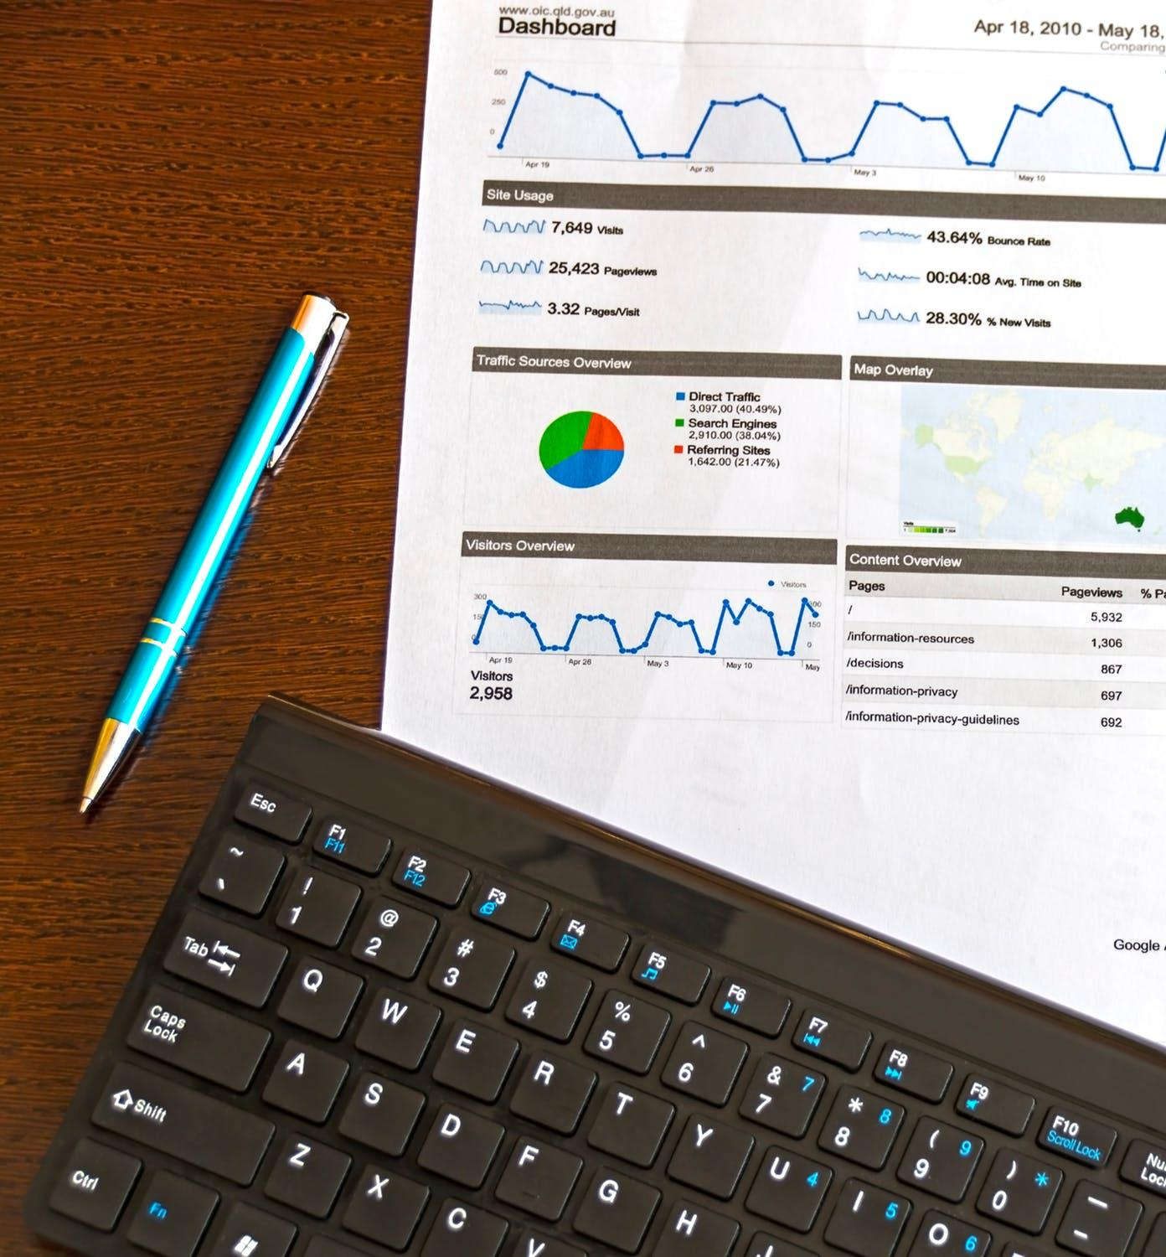
Why is there a need?
Government Pressure & Incentives:
40-45% emission reductions by 2030
SDTC & NZAF Millions in funding (Budget?)
Consumer Demand for Sustainability:
80% of US and CA consumers
Macro Trends Favoring ***************** :
Technological Advances
Government Regulations
ESG Reporting
Cost Savings:
Fuel accounts for up to 30% of total operating costs
Optimizing truck capacity and reducing
Big Companies are taking action:
Amazon, UPS, and Walmart cut costs by 10-15%
30% of Fortune 500 companies
​
Notes:
Government Pressure & Incentives:
The Canadian government targets 40-45% emission reductions by 2030. This provides direct opportunities for businesses offering eco-friendly logistics solutions.
Government grants and funding programs like SDTC (Sustainable Development Technology Canada) and Net Zero Accelerator Fund offer millions in funding to startups that reduce carbon footprints​. (Budget? )
Consumer Demand for Sustainability:
80% of consumers in the U.S. and Canada prefer to buy from companies with green practices, and businesses are pressured to showcase sustainable initiatives​(Penske Logistics).
Macro Trends Favoring ***************** :
Technological Advances: The rise of AI-driven route optimization, and GPS fleet tracking made it possible to minimize emissions and cut down on delivery costs.
Government Regulations: The recent Zero Emission Vehicle Infrastructure Program and fuel tax regulations incentivize companies to adopt eco-friendly logistics​
ESG Reporting: Major corporations are under pressure to report their carbon emissions as part of ESG (Environmental, Social, Governance) frameworks. Ariadne Logistics can help them meet their sustainability goals.
Cost Savings:
Fuel accounts for up to 30% of total operating costs for logistics companies. Optimizing routes with ************ can reduce fuel consumption by 10-20%
Optimizing truck capacity and reducing empty miles can save companies millions annually by improving efficiency. (NUMBER?)
Big Companies Taking Action:
Amazon, UPS, and Walmart have invested heavily in optimizing their fleets to reduce emissions and cut costs by 10-15%, proving the business case for green logistics​
30% of Fortune 500 companies have committed to reaching carbon neutrality by 2030​
1. Rise of Electric Vehicles and Sustainable Technologies
https://www.mckinsey.com/industries/automotive-and-assembly/our-insights/the-future-of-the-automotive-industry
2. Government Regulations and Emission Targets
https://www.canada.ca/en/environment-climate-change/services/climate-change/canada-action.html
3. Increasing Corporate Focus on Sustainability
https://www2.deloitte.com/global/en/pages/risk/articles/corporate-sustainability.html
4. Transportation Sector's Role in Carbon Emissions
https://www.iea.org/topics/energy-transport
5. Market Demand for Efficient Logistics Solutions
https://www.gartner.com/en/supply-chain

Slide 5
What are we Offering and trying to solve?
An Advanced Delivery Management Software(web-app & mobile)
using AI to optimize delivery routes, fleet allocation, and distribution planning
One-way/two-way
Current:
AI-driven algorithm route optimizing (Distance)
Customers’ allocation to routes
KPI Reports (Trucks, rent, fuels, maintenance, orders, volume)
Next Phase:
Customer order prediction (high-potential areas)
Route optimization by traffic and weather
Delivery time estimation
etc
Put your brand’s icon on every page
Notes:
Route Optimization Solution: These models minimize delivery distances and reduce carbon emissions by finding the shortest, most efficient delivery routes.
Real-time fleet management and dynamic optimization
Decreasing Distribution Cost(Trucks, rent, Fuels, maintenance)
We will be working on an algorithm focusing on resource allocation, and customer behavior analysis to ensure the most efficient and environmentally friendly service.
We can increase sales by Analyzing customer behavior, demand trends, and sales data to identify high-potential areas and focus efforts on regions with the greatest demand.

Slide 6
AI Usages (Data Models)
Where can we use this?
AI Distribution Route Optimization: Use AI to analyze historical sales and marketing data from each region to suggest optimized routes for sales representatives. It prioritizes visits based on potential success rates, customer behavior, traffic patterns, and peak sales times > Repeated
Real-Time & Predictive Traffic AI: This system optimizes routing for both delivery drivers and sales teams by considering real-time traffic data and predictive algorithms to avoid congestion and unexpected delays.
Collaborative AI Platform for Shared Logistics Routes: A platform where multiple companies can share logistics routes to increase efficiency. AI matches companies with similar routes to reduce transportation costs and environmental impact.
Put your brand’s icon on every page
Notes:
Vision Slide
Examples? Hubspot Blog?

Slide 7
Product’s current & future Features
Smart(AI) Route Optimization
Hierarchical classification of customers on the map
Sustainability Reporting & Carbon Credit Programs (add picture report)
Accurate estimation of arrival times at each destination through AI-driven planning
Capability to integrate with ERP, supply chain, sales software and solutions (move to what we offer slide?)
Allocating customers to routes based on distance
Create a report before and after (Params: the number of Trucks has been decreased, cost, mileage,
KPI > carbon reduction/order – 6 trucks – 500L (85km) > 5 trucks – 400 L
Notes:
Smart(AI) Route Optimization by: ranking and organizing destinations effectively, and optimizing delivery routes, considering factors such as distance, traffic, volume and weight of cargo
hierarchical classification of customers on the map, such as by region, area, zone, and route.
Sustainability Reporting & Carbon Credit Programs (picture report)
Accurate estimation of arrival times at each destination through AI-driven planning
Capability to integrate with ERP, supply chain, sales software and solutions (move to what we offer slide?)
Allocating customers to routes based on distance
Create a report before and after (Params: the number of Trucks has been decreased, cost, mileage,
KPI > carbon reduction/order – 6 trucks – 500L (85km) > 5 trucks – 400 L

Slide 8
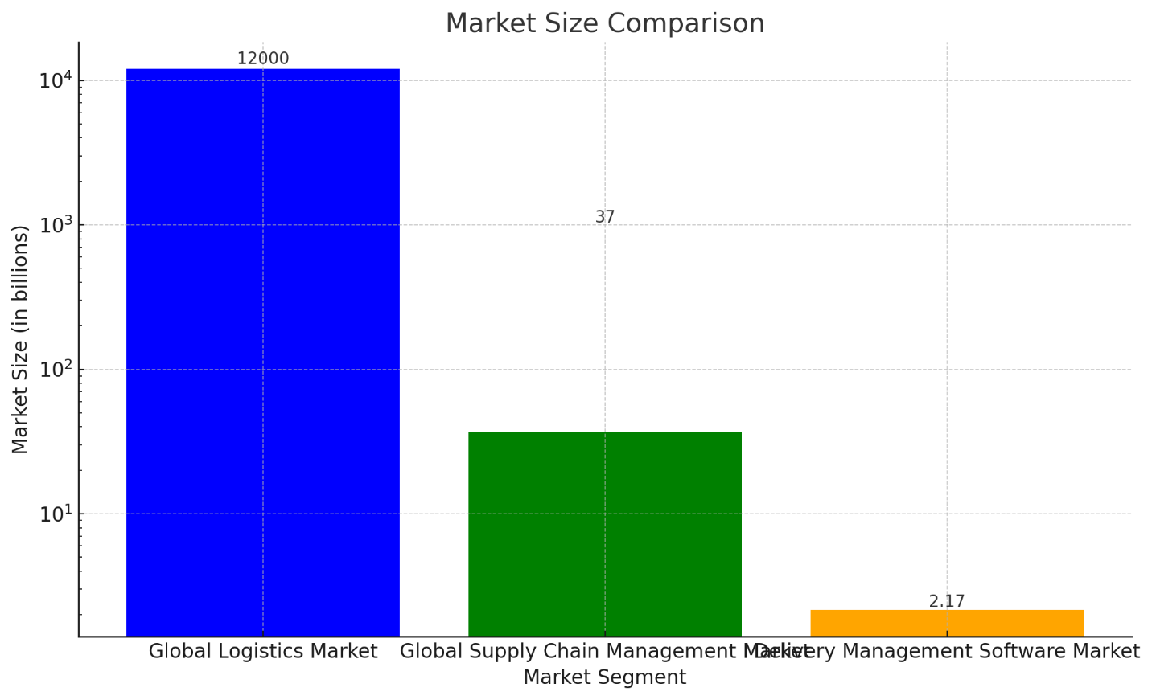
Size of Market
Market Size Summary
Global Logistics Market: (Approximately $12 trillion by 2027, with a CAGR of around 7%.)
Global Supply Chain Management Market: (Expected to grow from about $15 billion in 2023 to over $37 billion by 2030, reflecting a CAGR of around 13%).
Delivery Management Software Market: (Valued at approximately $2.17 billion in 2024, with significant growth potential.)
Notes:
Global Logistics Market:
Projected Size: Approximately $12 trillion by 2027, with a CAGR of around 7%.
Description: This market includes all logistics services, encompassing transportation, warehousing, and last-mile delivery.
Global Supply Chain Management Market:
Projected Size: Expected to grow from about $15 billion in 2023 to over $37 billion by 2030, reflecting a CAGR of around 13%.
Description: This sector focuses on optimizing the entire supply chain, including procurement, manufacturing, distribution, and logistics.
Delivery Management Software Market:
Current Size: Valued at approximately $2.17 billion in 2024, with significant growth potential.
Description: This market is a specific segment of logistics, focusing on optimizing delivery operations and enhancing customer satisfaction.

Slide 9
Industry (need a comparable table
Company Name | Overview | Revenue (2024) | Cost of Usage
Trimble Inc. | Offers fleet management and distribution. | $3.45 billion | $25 - $100 per vehicle per month
The Descartes Systems Group | Provides a comprehensive transportation | $470 million | Varies; $0.25+ per shipment or custom license pricing
Caliper Corporation | Offers transportation software solutions | Not available | Custom pricing based on requirements
ESRI Global Inc. | Specializes in GIS software with applications | $1.5 billion | Varies; contact for specific quotes
Verizon Connect | Offers telematics and fleet management solutions | Part of Verizon's overall revenue | $20 - $50 per vehicle per month
TrackoBit | A fleet management and vehicle tracking solution | Not available | $15 - $25 per vehicle per month
Microlise | Offers a range of telematics solutions | $30 million | $20 - $40 per vehicle per month
Notes:
Industry Overview Slide

Slide 10
Traction to Date
Proven Experience & Success:
With 15 years of experience in ERP systems, has driven successful outcomes for large-scale distribution, supply chain, and sales companies.
Our ERP solutions have been implemented in 5 large companies, supporting nearly 29,000+ customers across multiple provinces, showing proven efficiency and scalability in managing complex logistics and distribution operations.
Our ERP solution reduces CO2 emissions by 23.1%, optimizing delivery routes and minimizing fuel consumption.
Market Viability ?: Iran and Canada
Growing interest in sustainable and cost-efficient logistics solutions.
Early adopters show a 20-30% reduction in fuel costs and 15-25% improved delivery efficiency.
Carbon footprint reduction potential of 20-25%, aligning with corporate sustainability goals.
Roadmap & Near-Term Plans: (In visual)
Short-Term: Focus on sales strategy through trade shows, digital marketing, and customer outreach.
Product Enhancements: Real-time data integration (distance, traffic, load) and advanced reporting.
Long-Term: Launch a Green Certification Program for companies reducing emissions, creating a competitive edge.
Notes:
Traction Slide

Slide 11
Business Model
Model
Features
Pricing
Target Customers
Basic
Route optimization
$X/month
Small businesses
Pro
+ Green logistics
$Y/month
Mid-size companies
Enterprise
+ Custom integrations
Custom
Large corporations

Slide 12
Business Model
Model
Description / Price
Subscription
Different tiers based on company size and needs
Licensing
Flexible pricing for scalability

Slide 13
Business Model
Model | Features | Pricing | Target Customers
Basic | - Route Optimization for Cost & Fuel Reduction | $499/month | - Small to Medium-sized Distribution Companies
 | - Fleet Load Balancing |  | - Businesses Starting Sustainability Initiatives
 | - Basic Delivery Forecasting
Standard | - All Basic Features | $999/month | - Medium to Large Distribution Firms
 | - Cold & Hot Sales Path Integration |  | - Companies Seeking Enhanced Efficiency and Sustainability
 | - Real-Time Fleet Monitoring
 | - Driver Performance Optimization
Premium | - All Standard Features | $1,599/month | - Large Enterprises
 | - Advanced Sustainability Reporting |  | - Organizations with Aggressive Sustainability Goals
 | - Carbon Footprint Tracking |  | - Businesses Seeking Comprehensive Green Logistics Solutions
 | - Green Certification Support
 | - Priority Customer Support
Notes:
Business Model Slide

Slide 14
Revenue Flow????
Use the icons in the last slide to help you create a revenue flow for your business/industry
Notes:
Revenue Flow Slide

Slide 15
Customer Acquisition
Initial Customer Acquisition Strategies:
Targeted Marketing Campaigns
Networking and Partnerships
Referral Programs
Long-term Customer Acquisition Strategies:
Customer Relationship Management (CRM):
Customer Feedback Loop:
Educational Workshops and Training:
Ongoing Engagement:
Regular Updates and Newsletters:
Loyalty Programs:
Notes:
Customer Acquisition Strategy
Image at lowest layer can be swapped out

Slide 16
Additional Support for Canadian Distribution Companies:
Compliance with Regulatory Standards:
Ensure the system complies with Canadian regulations and industry standards governing data privacy, security, and consumer protection.
Localization and Multilingual Support:
Customize the system to support multilingual interfaces and accommodate diverse cultural nuances within Canada's multicultural landscape.
Integration with Canadian ERP Providers:
Collaborate with major Canadian ERP providers to seamlessly integrate the AI distribution solution with existing ERP systems commonly used in Canada.
Partnerships with Canadian Logistic Companies:
Forge partnerships with local logistics and transportation companies to enhance last-mile delivery services and leverage their expertise in Canadian markets.
Notes:
Tips

Slide 17
Team and Experience
CEO
CTO
COO
CMO
15 years in ERP systems, driving successful outcomes for large-scale supply chain companies.
Expert in AI and machine learning, leading the development of our core technology.
Experienced in scaling operations and optimizing business processes.
Skilled in digital marketing and building brand awareness in the tech sector.

Slide 18
Summary
List 3-5 key takeaways. Such as:
Market size
Core insight on product/market
Highlight any traction
Put supporting images / charts here
Notes:
Summary Slide

Slide 19
Fundraising ask
The amount you are raising
Investors that are currently involved
Notes:
Fundraising Ask Slide

